Slide 1
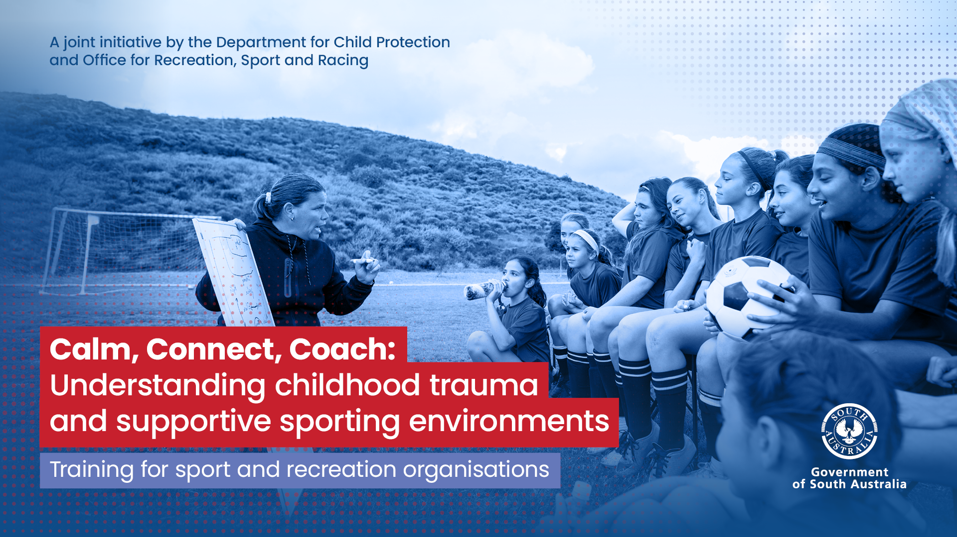

Slide 2

Acknowledgement of Country
Notes:
Acknowledgement of Country
We acknowledge and respect Aboriginal people as the state’s First Peoples and Nations, and recognise Aboriginal people as Traditional Owners and occupants of Land and Waters in South Australia.
Aboriginal children and young people have the right to grow up in a safe and nurturing environment where culture, Community, spiritual identity and traditional ownership of the land is supported, respected and celebrated.

Slide 3
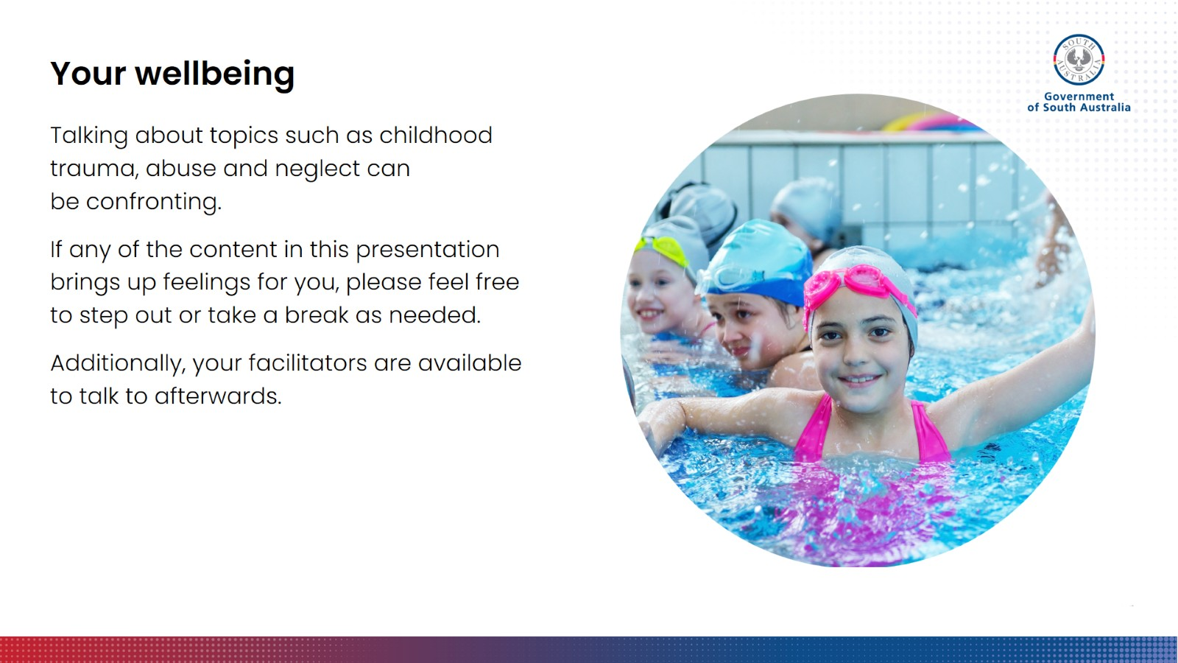
Your wellbeing
Notes:
Your wellbeing
Before we begin, we need to let you know that some the topics we will talk about today, such as trauma and child abuse, can be confronting. If any of the content today brings up feelings for you, please feel free to step out for a minute and take a break. Please also come and speak to us, if you feel you need some support.

Slide 4
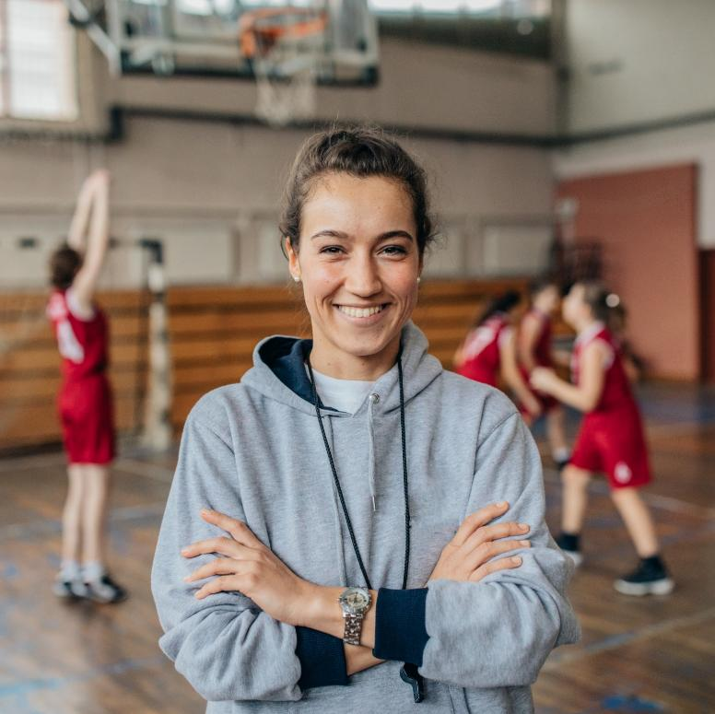

Introductions
About your facilitators
Housekeeping
Not to be confused with mandatory notifier training or child safeguarding training
Insert
QR code
here
Join at menti.com
Use code xxxx xxxx
If you wish to use Mentimeter to complete the pop quiz and feedback form, copy the questions into Mentimeter and add the relevant code or QR above. Once completed this text box can be deleted.
Notes:
Introductions
Introduce yourself and a little bit about your role and experience; cover any necessary housekeeping topics.
Although we will talk about issues around child protection and how to support children and young people to participate in your activities, this is not to be confused with mandatory notifier training. We will not be talking about what you need to do in the event that a child discloses something to you, or how to ensure children and young people are safeguarded from potential harm and abuse in your environments. To obtain that information, you will need to access accredited child safeguarding training through your club or governing sport or recreation body, or complete Child Safe Environments or RRHAN.

Slide 5
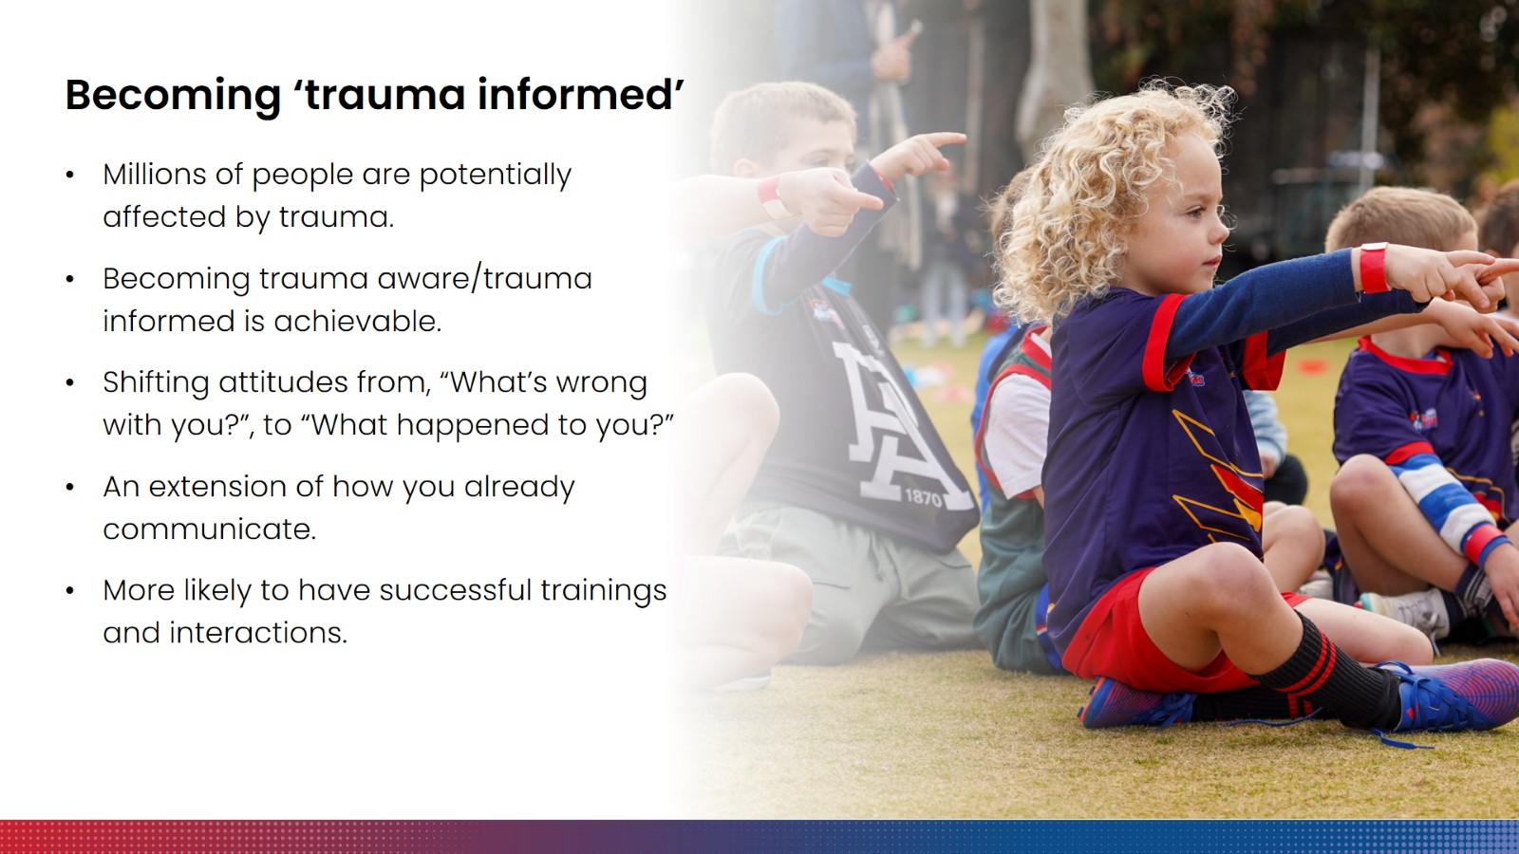
Becoming ‘trauma informed’
Notes:
Becoming ‘trauma informed’
The aim of today is to provide you with information about the impacts of childhood trauma and equip you with some trauma-informed strategies that can be used across a range of sport and recreation settings.
In Australia, millions of people of all ages are affected by or have experienced trauma. This includes a significant number of children and young people. For those of you who currently coach or interact with kids in your clubs and organisations, it is possible that you may have already coached children and young people who have experienced trauma and early life adversity, maybe without realising. So, it is always a possibility that someone you encounter may have experienced trauma, and this may not always be obvious to you.
We also know that experiencing trauma particularly at a young age can have all sorts of impacts, and this can mean kids may need more support in a whole range of environments, including participating in organised sport and recreation activities. One of the most important things we can do to help children with impacts from trauma is ensure our sport and recreation environments are really safe and supportive, and the key to achieving this is to work with the people who are the backbone of these sport and recreation organisations to help them become ‘trauma informed’.
The good news is that becoming trauma-informed is very achievable and does not require a significant investment of your time and effort. We are not talking about becoming an expert in trauma, or developing a specialist set of competencies and qualifications. Being trauma-informed is as simple as having a basic understanding of what trauma is and how it can look and feel for people, being aware of the possibility of trauma as a factor in the lives of people you encounter, and accordingly taking that awareness and understanding into your day-to-day interactions.
A trauma-informed approach, at its most basic, is one that appreciates that everyone is shaped by their experiences. It’s an attitude shift – when you enter interactions, you ask yourself: ‘What’s happened to you?’ instead of ‘What’s wrong with you?’
When you think about it, this is how we would all ideally like to be treated: with compassion and curiosity, instead of judgement, especially if we are having a rough time. So, if you’re thinking, ‘Well, of course that’s how I already try to treat people’, that’s great because it means that you are already well on your way. A trauma-informed approach can just be an extension of how you already communicate, and is something you can do every day, even outside of the coaching environment.
We lose nothing by erring on the side of being trauma informed, and in fact we make it more likely that our interactions will be positive ones. For sport and recreation coaches specifically, understanding the impacts of trauma and being able to implement a few trauma-informed skills and strategies will make your sessions more successful across the board. This is because trauma-informed skills and strategies focus on helping children feel calm and settled, and supported to take on new challenges. Children with more severe impacts from trauma will need you to use a trauma-informed approach, but ultimately, strategies that work for traumatised kids work for everyone.

Slide 6
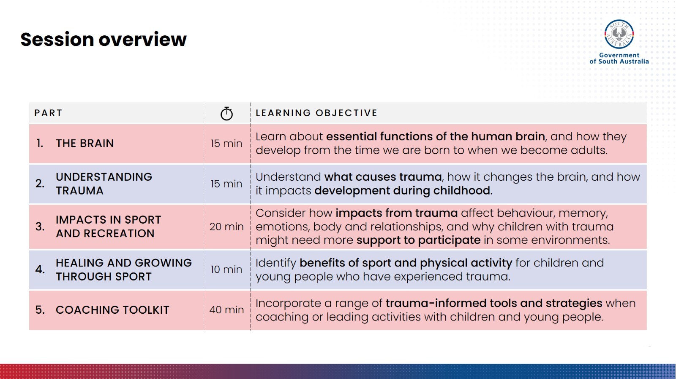
Notes:
Session overview
Before we get to the strategies, it’s important to understand a few essential functions of the human brain and how the brain develops when we are young. From there, we can explore what happens to the brain and development when a child is exposed to trauma, and how those impacts look and feel for children when they are trying to do everyday activities like participate in sport and recreation activities.
The reason for this is so that we can build the foundations of your knowledge first, which will inform the how and the ‘why’ for the practical tools and strategies presented in part 5. With this foundational knowledge, you can use strategies flexibly when you are planning and leading your sessions, and adapt them as you need to suit certain situations or certain young people you may be working with.

Slide 7
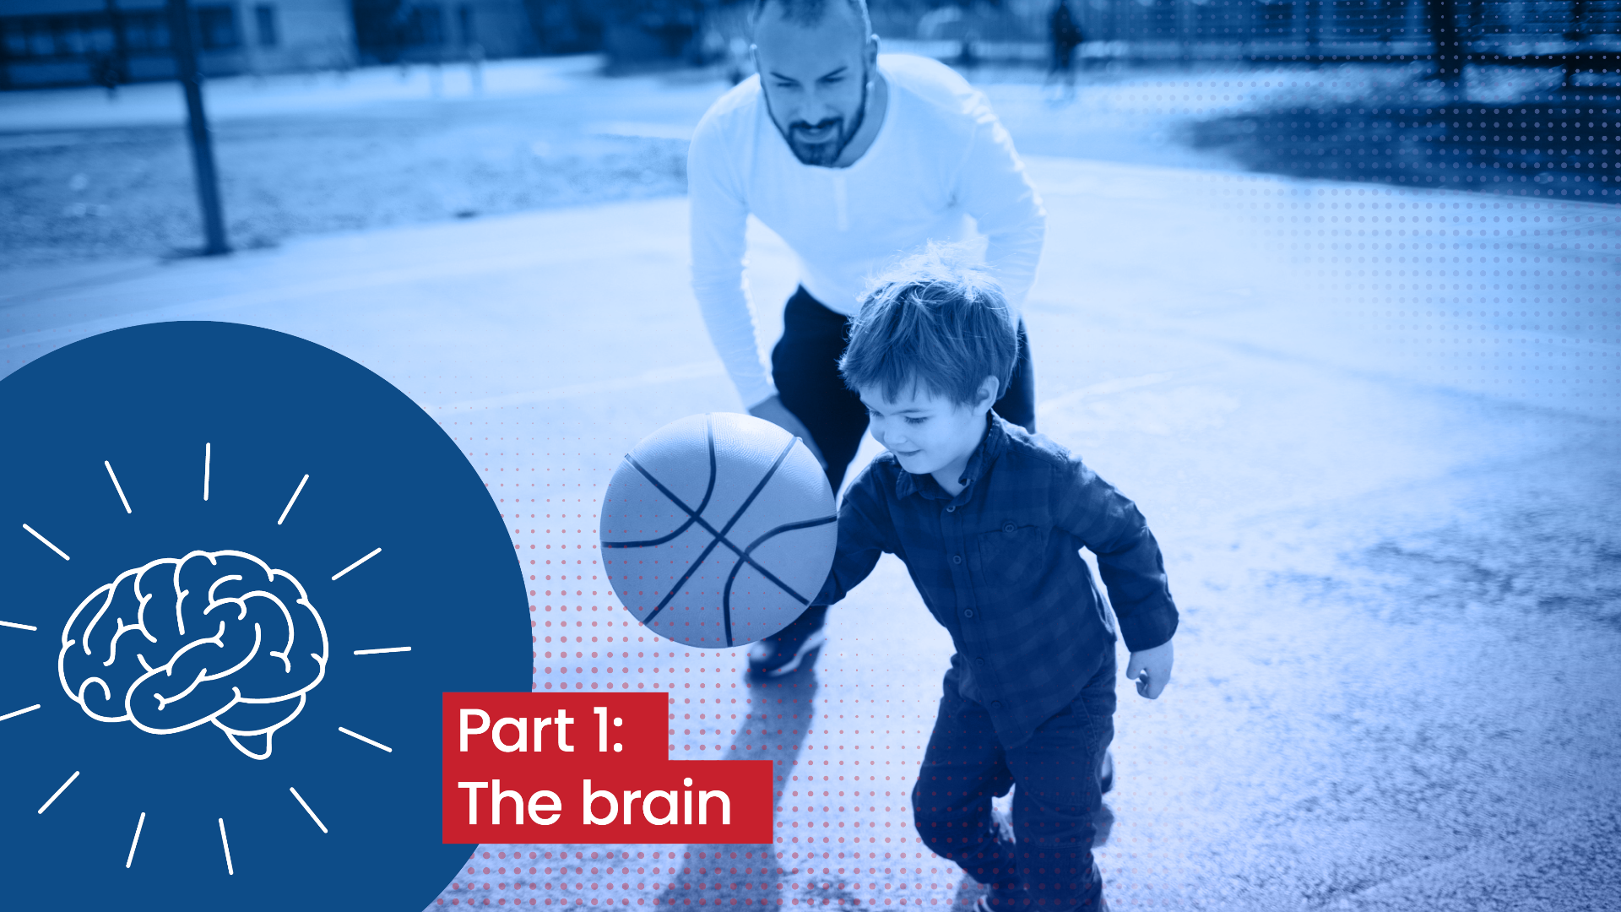
Notes:
Introductory slide
To begin to understand trauma, we first need to understand a few essential functions of the human brain, and how these develop from the time we are born to when we become adults.

Slide 8
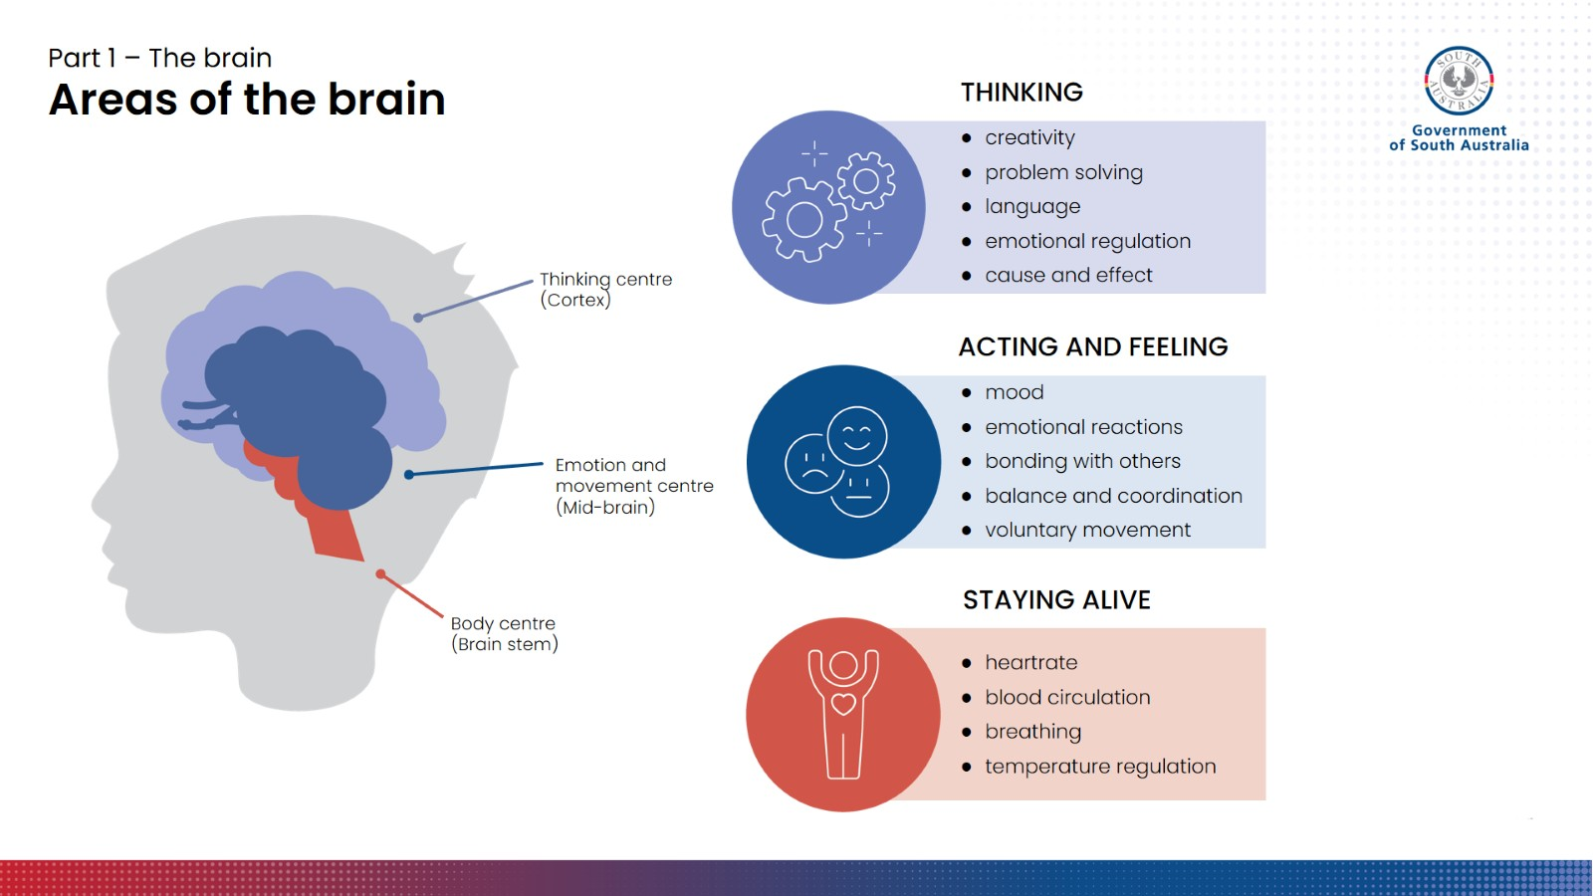
Notes:
Areas of the brain
The brain is a very complex organ and is also arguably our most important organ, because of how many things it controls.
For the purpose of this training, we just need to know about three main areas of the brain and their functions. These are:
Brain stem (body centre) – responsible for keeping us alive.
Functions include breathing, heart-rate, temperature regulation.
The brain stem is already fully developed by the time we are born.
Mid-brain (emotion and movement centre) – responsible for helping us act and feel.
Functions include balance and coordination, voluntary movement, play, emotional reactions, bonding and relating to other people.
The mid-brain is developing fastest between the age of 6 months to four years.
During this time, very young children acquire a range of new movement skills like crawling, walking, climbing, kicking and throwing.
The emotional centre of the brain pretty much rules the lives of children during this period of life, which explains the bursts of emotional behaviour and tantrums.
Cortex (thinking centre) – responsible for thinking.
Functions include problem solving, learning, reasoning, planning, cause and effect, creativity and language.
Young children feel and act at the same time – they don’t have a chance to think first. The thinking centre needs to mature a bit more before they can start to constrain their emotion-driven behaviours.
The cortex also helps us to regulate and make sense of all the other input we receive – what we hear, smell, feel, etc.
The cortex is developing really fast from about the age of three years, and as we enter primary school is bringing all sorts of new skills online.
Kids are like sponges during these years. Their brains are biologically primed for learning, and are hugely shaped by the people and experiences they are exposed to – for better or worse.
Our cortex continues developing all through adolescence, and in fact there are certain parts of our pre-frontal cortex that don’t completely finish developing until our mid-20s.

Slide 9
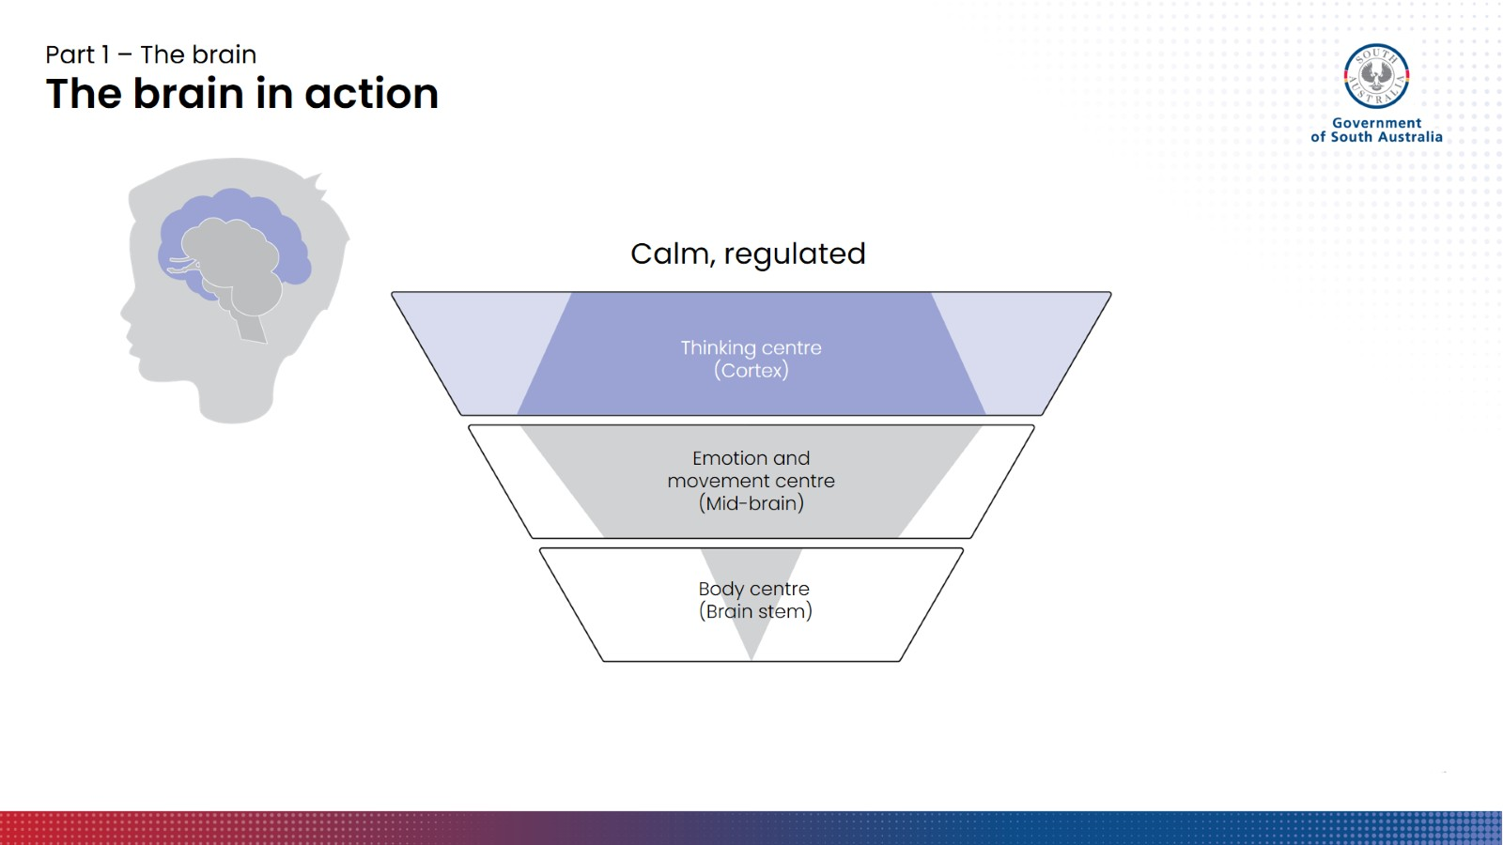
Notes:
The brain in action (1)
Our brains develop from the bottom-up or the inside out, and as we grow, the part of our brain that is primarily in control and driving our behaviour changes. By the time we are adolescents, the thinking centre is usually firmly behind the wheel, with the other two areas working away in the background playing their respective parts.
When we are feeling calm, our thinking centre (represented as the top section of the pyramid) is in control. In this regulated state, we can problem solve, learn, and communicate and receive complex ideas. Hopefully, we would have our thinking brains switched on when we are in a huddle, getting coached, learning a new skill or drill, etc.

Slide 10
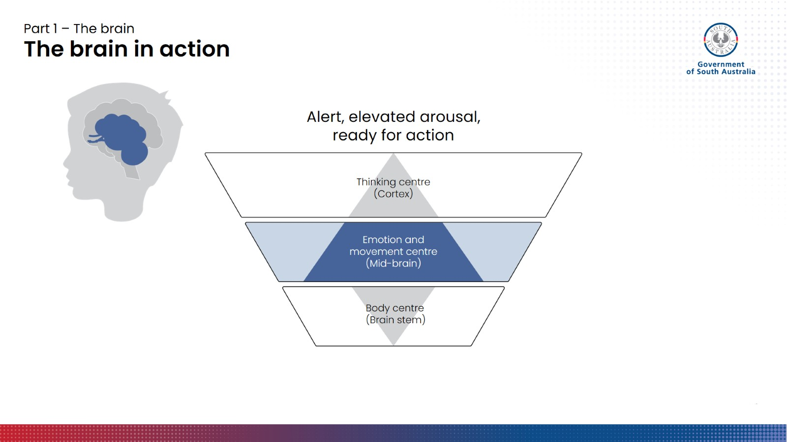
Notes:
The brain in action (2)
Sometimes, our emotions will flare up – for instance, if we feel insecure or unsafe, threatened, lose our temper, or become too upset to speak. When this happens, the ‘feeling and acting’ and ‘staying alive’ areas of our brain (the mid-brain and brain stem) can try to kick the thinking centre out of the driver’s seat.
In this state, emotional reactions might start to bubble up and spill over, and you might find yourself expressing things behaviourally before your thinking brain has a proper chance to filter out things you probably shouldn’t say or do. We might also get some physiological sensations like an elevated heartrate, sweaty hands, etc.
You would not perform as well on a test if you were in this kind of state. The more active our feeling and acting centre is, the more our functional intelligence decreases.
This kind of reaction can sometimes be a good thing– especially in sport. Redirecting energy to the parts of your brain responsible for movement and quick reactions is often helpful. For example, getting fired up might help your performance in a game – aggression for the ball is something coaches will often encourage – but getting too much of a rush of blood to the head might get you a costly penalty or cause you to make a tactical mistake.

Slide 11
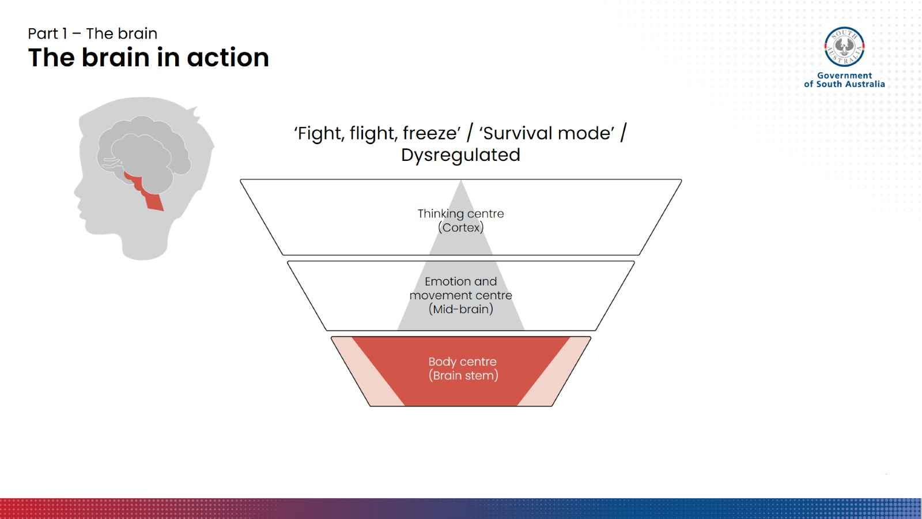
Notes:
The brain in action (3)
If you are in a truly dangerous situation, or your brain thinks you are, your brain will try very hard to keep you safe and protect itself. It does this by redirecting control and ‘brain power’ to the area of the brain responsible for our basic survival and keeping us alive.
In this state, not only would you not perform well on a test, you might not even be able to understand the questions. When the survival area of the brain takes over, you are unable to undertake complex thinking, learning and memory tasks. Your brain has shut down access to those functions, because they are not needed.
Being in this state is usually pretty uncomfortable – it could feel like your chest tightening, heartrate through the roof, sweating, trembling, dizziness, etc. It can make you feel like you need to flee the situation or punch someone in the face. You may have also heard this referred to as the ‘fight, flight or freeze’ response, or ‘survival mode’.

Slide 12

Part 1 – The brain
‘Flipping your lid’
Notes:
‘Flipping your lid’
Being aware of how our brain and body is feeling can be really helpful, especially for kids who want to communicate that they are not doing OK or are acting in a way that they know isn’t OK, but just don’t have the ability to control it or the words to talk to adults about it.
A really helpful way of thinking and talking about this is to use our hand as a model of the brain. And, instead of talking about ‘survival mode’ or ‘fight/flight’, we can talk about ‘flipping your lid’.

Slide 13
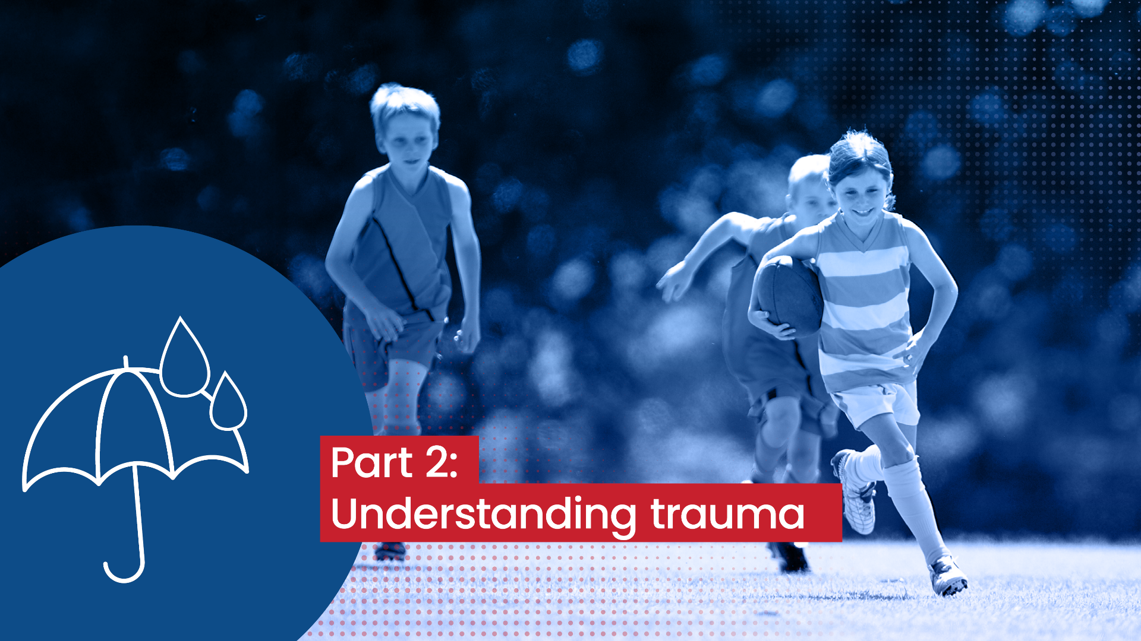
Notes:
Introductory slide
In this part, we will explore what causes trauma and how it changes the brain. We will also talk about what happens when children are exposed repeatedly to traumatic events and situations, and how it can impact their development.

Slide 14



Part 2 – Understanding trauma
Defining trauma
Stress (positive stress)
Crisis (tolerable stress)
Trauma (toxic stress)
Notes:
Defining trauma (part 1)
There is a difference between stress, crisis and trauma. Everyone experiences stress at some point, including children, although we often think of stress as more of an adult concept. For children, stress usually means exposure to the unknown or unpleasant in short, sharp bursts. These experiences can often turn out to be positive experiences that generate learning and build resilience.
Examples of stress:
The first day of school, kindy, a new job
Trying a new or unfamiliar food
Learning how to toilet train
Signing up for a new hobby
Taking yourself out of your comfort zone socially
A crisis is something many children will experience, which has the potential to impact them negatively. A crisis generates stress as well, but with the support of a safe, predictable adult or primary caregiver, the stress is usually tolerable, and there may be no negative long-term consequences. Keeping in mind, what may be tolerable for one person might be traumatic for another.
Examples of crisis:
Death of a family member, a pet, etc.
Getting lost at the shops
Falling off the monkey bars at school and breaking your arm
Parents’ divorce
In contrast to a crisis, trauma generates a level of stress that is toxic to the brain and body.

Slide 15

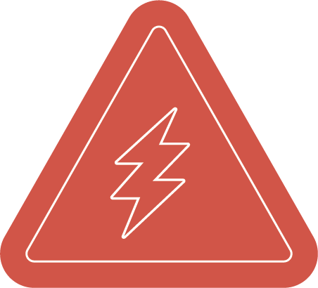

Part 2 – Understanding trauma
Defining trauma
  series of events
  abuse, maltreatment, neglect
  “Trauma is an event or series of events such as abuse, maltreatment, neglect or tragedy that causes a profound experience of helplessness leading to terror.”
  event
– Institute of Recovery from Childhood Trauma
‘Simple’ trauma
Complex trauma
Developmental trauma
in childhood
Notes:
Defining trauma (part 2)
When we talk about trauma, we are talking about ‘an event or series of events such as abuse, maltreatment, neglect or tragedy that causes a profound experience of helplessness leading to terror’. Trauma shatters our sense of safety, stability, trust and innocence.
[click to reveal additional graphics – 5 clicks in total]
[Click 1] A single event or incident of trauma might be something like a car accident or a near-death experience. While these events are still experienced as overwhelming and terrifying, and might result in short to medium-term post-traumatic effects, with support to recover, pervasive and long-term psychological impacts can be avoided.
[Click 2 + 3] When trauma occurs on multiple occasions or as a series of events, often involving abuse, maltreatment or neglect, this is called ‘complex trauma’.
Complex trauma has more far-reaching effects on our psychological wellbeing than a once-off traumatic incident. It can impact how we feel about ourselves and the world, how we go about relationships, and how we cope with stress and negative feelings every day. Complex trauma is often associated with violence—for instance, surviving domestic violence, or being caught up in a violent conflict like a war or genocide.
[Click 4] When complex trauma occurs in childhood, this often means children have experienced abuse or neglect in the context of a close relationship. When child protection becomes involved, it often means the adults who were responsible for protecting and caring for the child have been unable to do so, and may even have contributed to abuse.
Aside from exposing children to feelings of helplessness and terror, these experiences also disrupt children’s ability to form safe and supportive relationships because they have often learnt that other people are not safe and may cause them harm. Knowing that their caregivers will consistently protect and care for them is key for children to be able to feel safe so they can focus on learning and growing.
[Click 5] When children don’t feel safe and can’t focus on learning and growing because of the complex trauma they are experiencing, this results in developmental trauma.

Slide 16
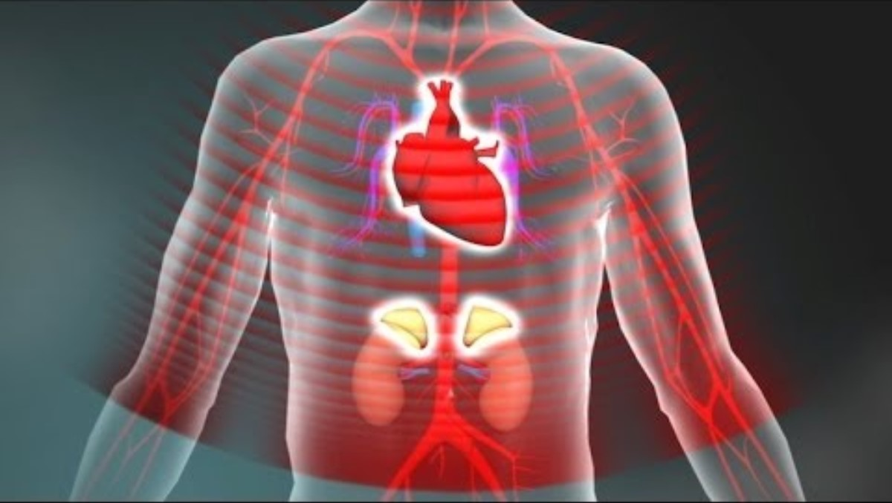
Part 2 – Understanding trauma
Toxic stress and development trauma
Toxic stress derails healthy development | YouTube
Notes:
Toxic stress and developmental trauma [video]
Developmental trauma occurs when there is a build up of toxic stress chemicals, which affects how the brain grows and forms connections. As we discussed in part 1, children’s developing brains are like sponges, and will be shaped by what they are exposed to, for better or worse.
Now we will watch a short video which explains what toxic stress does to children’s development.
The video outlines the following information:
Activation of the stress response system results in a rush of adrenaline, increased heart rate, elevated blood pressure, and the release of stress hormones like cortisol.
When a child has a supportive caregiver relationship, these responses are brief and return to normal quickly.
In severe situations like abuse and neglect, where there is no caring adult to act as a buffer for stress, the stress response can be prolonged.
Even when there is no apparent threat, the extended absence of care from adults can activate a child’s stress response system.
Constant, extended activation of the stress response overloads our brains and bodies with cortisol, which can have serious, lifelong impacts. We call this ‘toxic stress’.
Over time, children’s stress response systems can be stuck permanently on ‘high alert’.
In the areas of the brain dedicated to learning and reasoning (the thinking centre), prolonged stress activation can actually reduce the neural connections that are meant to form in this area of the brain, just at the time when they should be growing new ones.

Slide 17















Part 2 – Understanding trauma
Impacts?
Survival brain
Thinking brain
Emotional regulation skills
Building relationships.
The younger you are, the more vulnerable your brain.
Problem solving.
Understanding cause and effect, long-term consequences.
More toxic stress > more time with ‘lid flipped’.
Emotional regulation skills.
Notes:
Impacts?
So, what does a brain hijacked by toxic stress look and feel like?
Firstly, it means that even after the child is no longer in the unsafe environment, they will often still struggle to feel safe, as their body is will continue releasing more stress chemicals than normal. Those chemicals tell their brain and body that they are unsafe, even when there is no actual threat.
And if we think about the order in which the brain develops, very young children (up to about the age of three years) are especially vulnerable to toxic stress. It is a myth that very young children won’t be affected by traumatic events, because they are too young understand what was going on or remember things clearly. They might not have a clear or conscious recollection of events, but the body remembers.
As the video we watched demonstrates, the more toxic stress is pumping through you, the more time you spend on high alert (i.e. with their ‘lid flipped’). This means children’s thinking brain spend less time in control, while the survival area of the brain spends more time in control. This can have a range of effects on children’s development.
We can understand this by thinking about the difference between two paths in a garden: one that is well-worn, and one that’s overgrown. The path is well-worn because people are walking down it all the time. Children walk down their ‘survival mode’ path a lot, so it becomes the natural, default options. [Click to trigger overgrown path animation]
The path that isn’t used as often starts to become overgrown. For children exposed to lots of toxic stress, this is their ‘thinking brain’ path. [Click to reveal skills and opportunities]
The problem with not using the overgrown path is that it then becomes harder to access over time, and it’s easier to just keep going down the well-worn (survival brain) path. As a result then, kids don’t have as much access to the benefits at the end of the thinking brain path. They have far fewer opportunities to develop and practice certain skills like problem solving, emotional regulation, and understanding cause and effect and long-term consequences.
But hurt brains can recover. The overgrown path can be pruned back. The brain is not hard-wired, and never stops being capable of change. That is something we will come back to later, in Part 4.

Slide 18
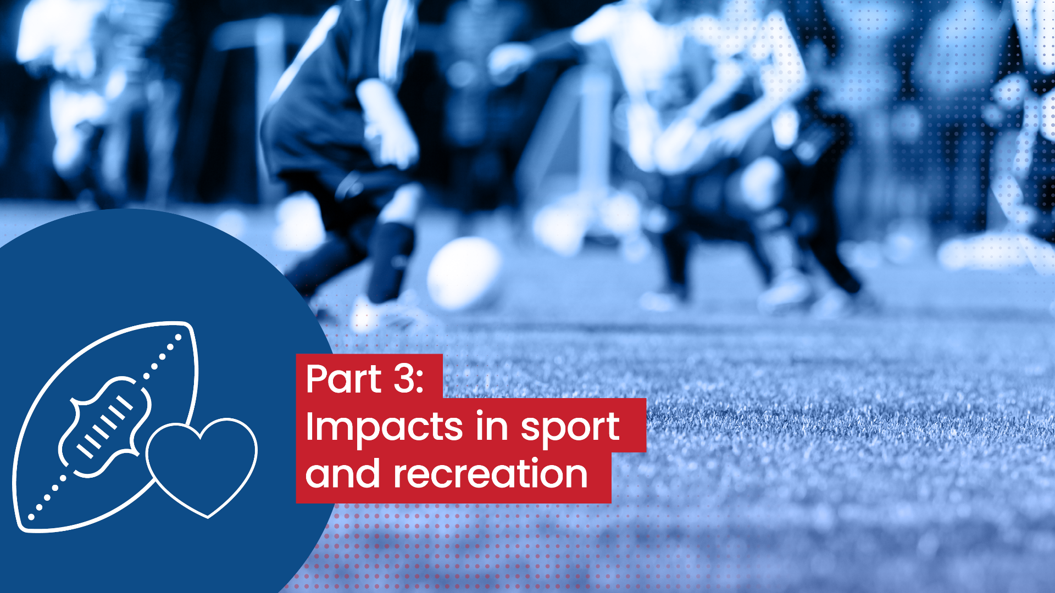
Notes:
Introductory slide
This section extends our understanding of how childhood trauma affects development, and considers how those impacts might translate to sport and recreation settings.

Slide 19
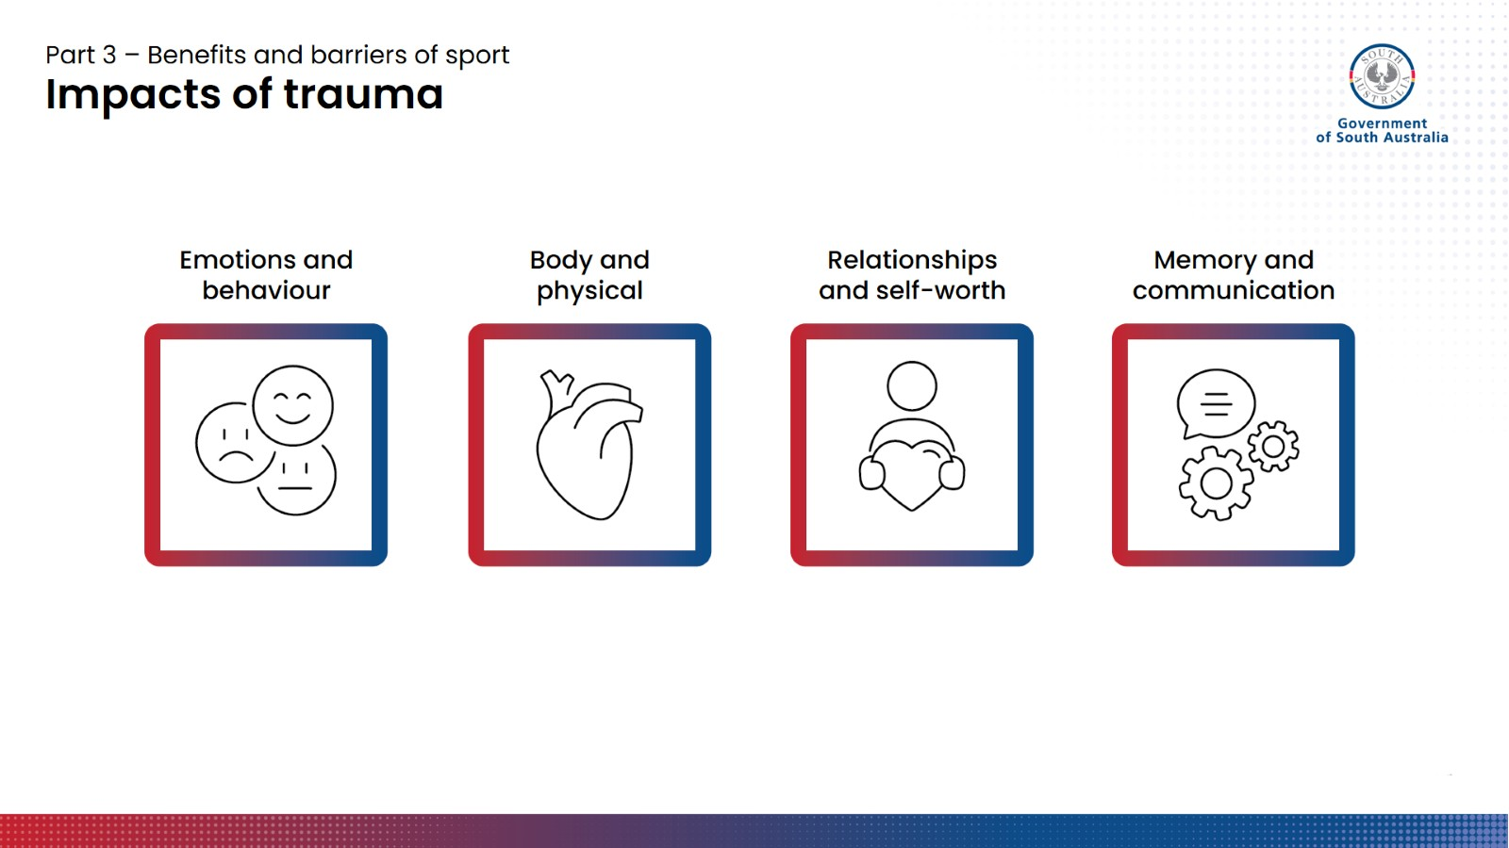
Notes:
Impacts of trauma
Childhood trauma can have a range of impacts on emotions and behaviour, physical health and the body, how children see themselves and their relationships with others, and their memory and communication skills.
These impacts are very individual. Every child has a unique personality and set of experiences, and so the impacts for them will be unique too. However, there are some common themes.

Slide 20
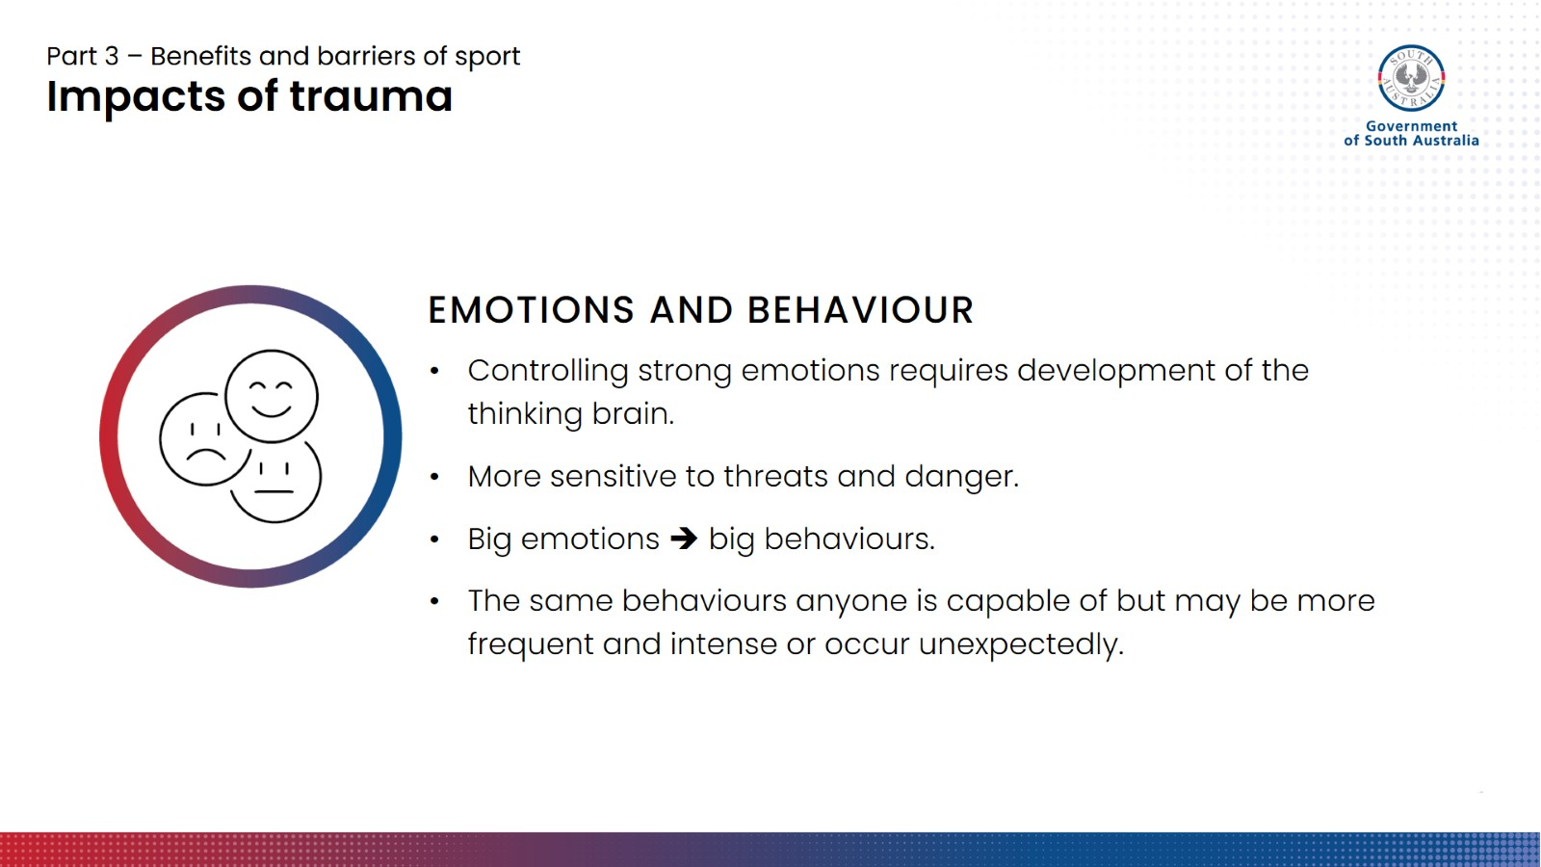
Notes:
Emotions and behaviour
As we learnt earlier, young children (pre-school age) are not good at managing their emotional responses to things, leading to tantrums and so forth. Getting a handle on this requires further development of the thinking brain.
Children with developmental trauma may struggle to manage their emotional responses in certain situations, more so than their same-aged peers. They are also much more sensitive to threats and danger, and so what might provoke a small reaction or even no reaction for one child, might trigger something massive for another or make them flip their lid. Children with impacts from trauma will often need more external support to manage their feelings.
When a child’s thinking brain is struggling to keep control, big emotions can lead to big behaviours. Often these are impulsive – feeling and acting are happening at the same time, and there is no thinking brain to intervene.
A critical point here is that behaviours that arise from overwhelming emotions are not unique to children with developmental trauma. Every human is capable of shutting down their thinking brain and flipping their lid.
[Key message] Children who have experienced trauma have the same behaviours as all children, but because their brains are more ready to perceive and react to danger, those behaviours may be more frequent and intense, or crop up in situations when you wouldn’t expect them to.

Slide 21
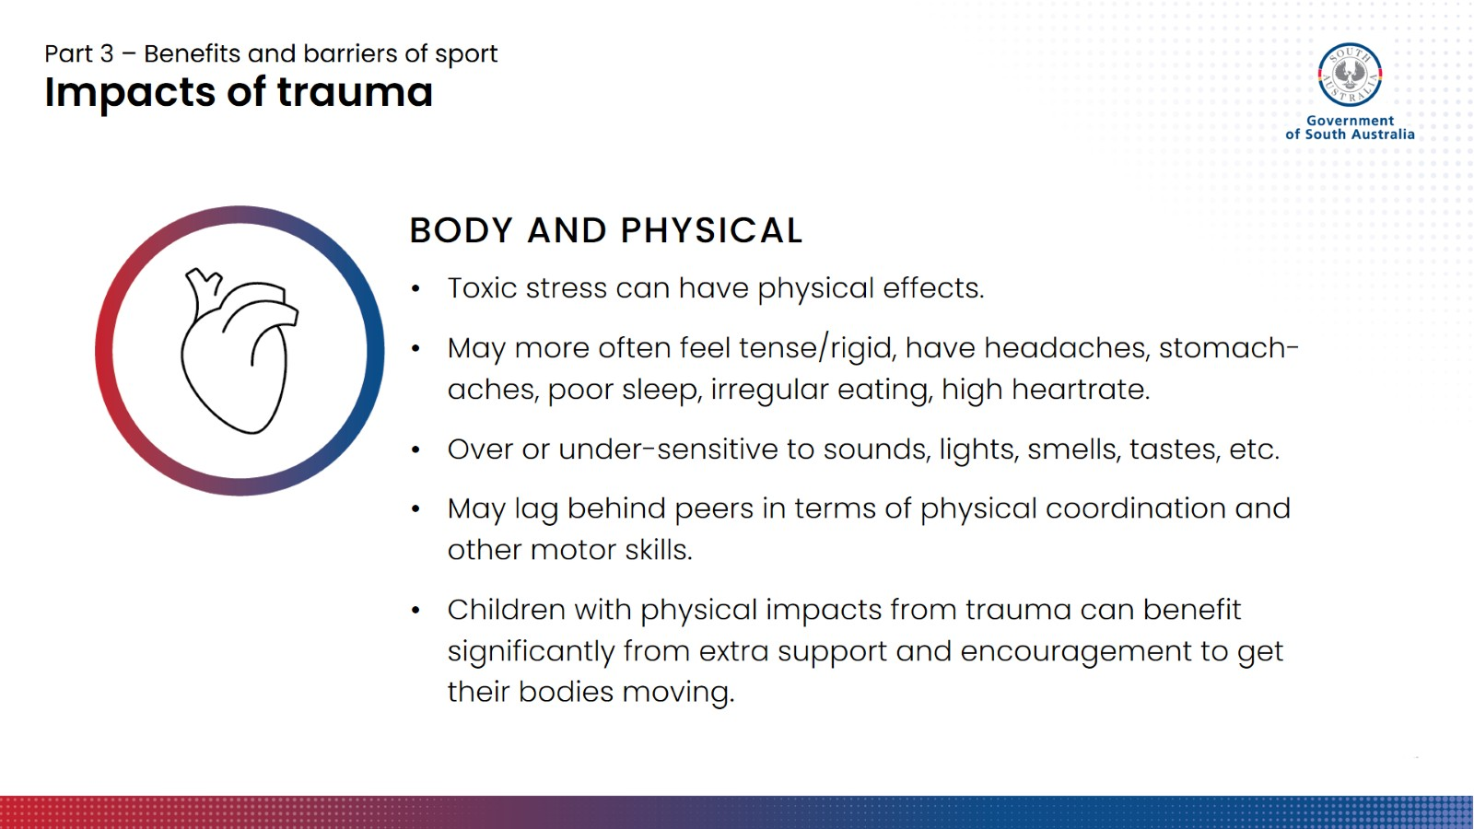
Notes:
Body and physical
When toxic stress is released, as we know, it can impact brain chemistry and connections, but it can also have a range of impacts on the body.
This could be feeling very tense and rigid a lot of the time, getting regular headaches and stomach aches, poor sleep, irregular eating patterns, a high heartrate, and so on. These might sound familiar, as they similar to what an adult experiencing stress might feel from time to time. However, adults are generally more capable of managing stress, so imagine what this must feel like for a child.
Physical symptoms of stress can affect our ability to go about our daily lives in a variety of ways, and there is the possibility that these can flow on into sport environments. For instance, feeling sick/unwell, missing sessions more frequently, or being too tired to perform well.
Another way trauma can impact children physically is how they experience things through their sense. Children may be very sensitive to things like sounds, sights and lights, touch, taste and smell, or alternatively under-sensitive to them. This could look like not reacting well to bright lights or loud environments, or seeking out stimulation due to low sensitivity, for instance, constantly fidgeting or always listening to music. Over- or under-stimulation can be very uncomfortable, and leads to kids feeling overwhelmed.
Sport environments have the potential to be overstimulating—there might be sounds of squeaking shoes, whistles going off, yelling, movement, bright floodlights—and there is not much we can do about that. Kids may be OK to cope with these for a while, but might burnout more easily or need a bit of recuperation time out of the busy, stimulating environment.
Physical coordination and motor skills can also be impacted. Research indicates that children who have experienced early childhood trauma are 5 to 7 times more likely to be behind their peers in this area. If this is the case, kids who are not as physically developed or coordinated as their peers may take longer to develop a skill or physical competency. Coaches may need to be aware of this and provide more guidance/opportunity to practice, and support and encouragement.
All kids will have times when they feel tired, sick, or are having a rough day and simply can’t cope as well with all the sights, sounds and movements. However, children with impacts from trauma may experience these on a more regular basis, so it is good for coaches to be aware of and understanding about potential underlying reasons, and be prepared to support a wide range of abilities.

Slide 22
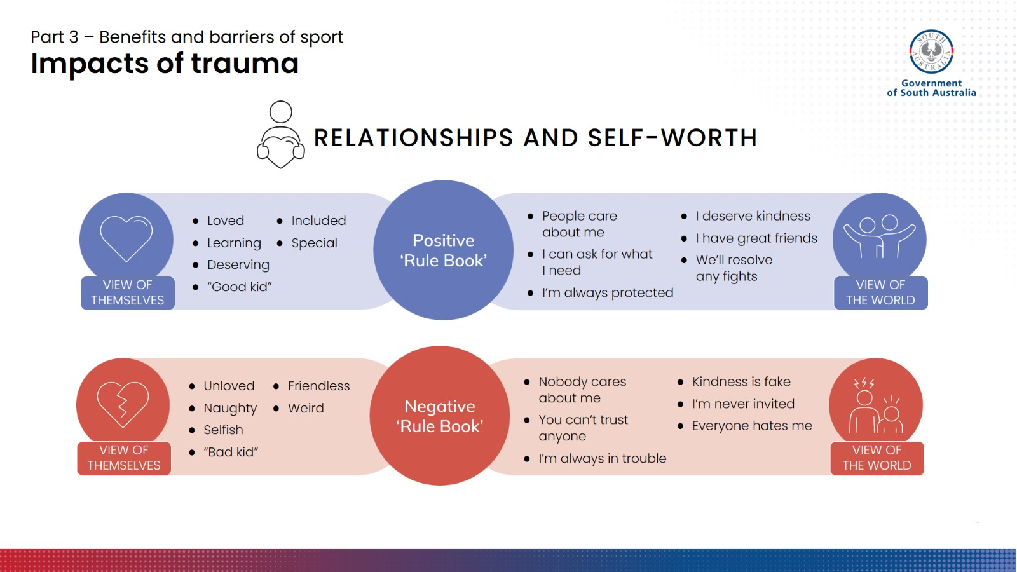
Notes:
Relationships and self-worth
How we go about relationships and develop a sense of self-worth is heavily based on our past experiences. Through these experienced, we develop a ‘rule book’ for what it means to interact with other people, for how people see us, and how we see ourselves.
A child who has not always had consistent, nurturing, safe caregivers is likely to develop a different ‘rule book’ to a child who has always had their needs met. The child who has been emotionally cared for by their parents is most likely to see themselves as a ‘good kid’, as loved and deserving of kindness and care. Kids with a positive rule book know that conflicts can always be worked out and that they can ask for what they need.
The ‘rule book’ for a child who has been abused or neglected might tell them that they are ‘bad kid’ who doesn’t deserve care, kindness or respect. The negative rule book tells children that adults are unsafe and untrustworthy and don’t care about them. It can take a long time to rewrite this negative rule book.
Children with complex trauma have also often grown up with adult authority figures who are extremely unreliable at best, and abusive at worst. This can impact how they respond to other adults and potential authority figures such as teachers or adults leading sport/recreation activities. Children might:
react defensively or aggressively if they perceive they are being attacked or criticised.
reject attempts to relate to them, and come across as guarded and indifferent.
exhibit controlling behaviours – towards yourself as the authority figure, or towards their peers – as a way to try to avoid further hurt.
Alternatively, children and young people may be overly compliant. This can be harder to detect at first and may not cause disruption to your session. However, it is something to be aware of, because overcompliance can mean children don’t voice their needs, and can also be very vulnerable to being taken advantage of or abused further.

Slide 23
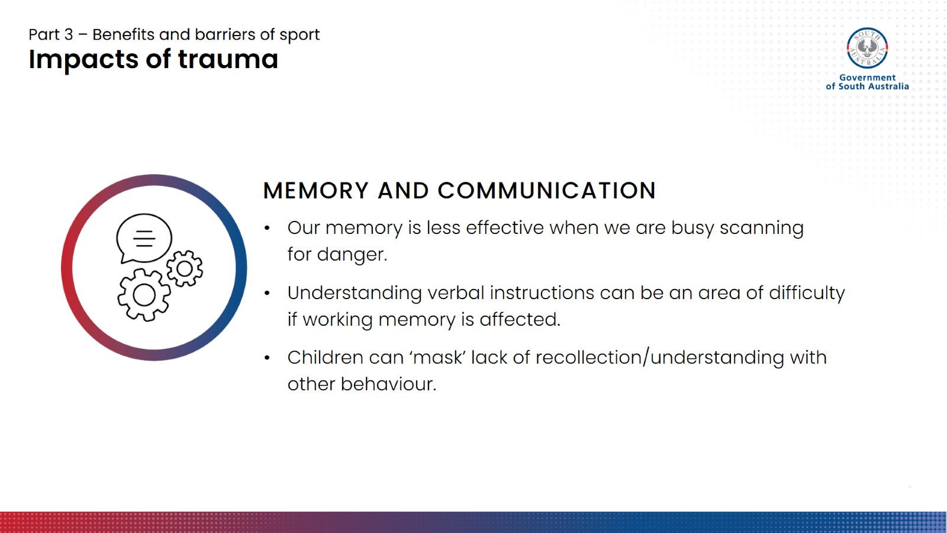
Notes:
Memory and communication
If a child is ‘on guard’ and feeling unsafe, their body may be scanning for danger instead of forming new memories, even before we start to see any other unusual behaviour. When children have their ‘alarm system’ turned on, their memory is less effective both in the short-term (i.e. recalling what has happened throughout the day) and for ‘working memory’.
Our working memory is what allows us to receive a small amount of information and manipulate it for the purpose of planning and strategising, reasoning, and making decisions. We use working is used in sport all the time. For instance, during a drill where you have to move in a certain pattern or sequence, your working memory keeps place of where you are and what bit comes next. When playing a game, your working memory helps you to remember where your teammates and opposing players are set up, and uses that information to plan what you are going to do next.
Working memory also helps us to remember multiple steps of a task we need to complete, and to understand how to action verbal instructions. Coaches rely heavily on verbal instruction. Coaches need to communicate to set up and run drills, give feedback and coaching points, and manage varying size groups of kids or adults—all while trying to keep sessions to time. On top of that, every sport or activity tends to have its own internal lingo. This is a lot of verbal, and potentially unfamiliar, information to take in.
This can be a particular area of difficulty for children living with impacts from developmental trauma. When kids don’t understand or recall what you’ve asked them to do, they can be quite good at masking this with other behaviour. As a result, if they then don’t follow the instructions you’ve laid out, you might interpret this as refusal, laziness, distraction, or just mucking about. But there is more going on under the surface, and there are things we can do to overcome these barriers.
We will look at this in the ‘Coaching toolkit’ section in Part 5.

Slide 24
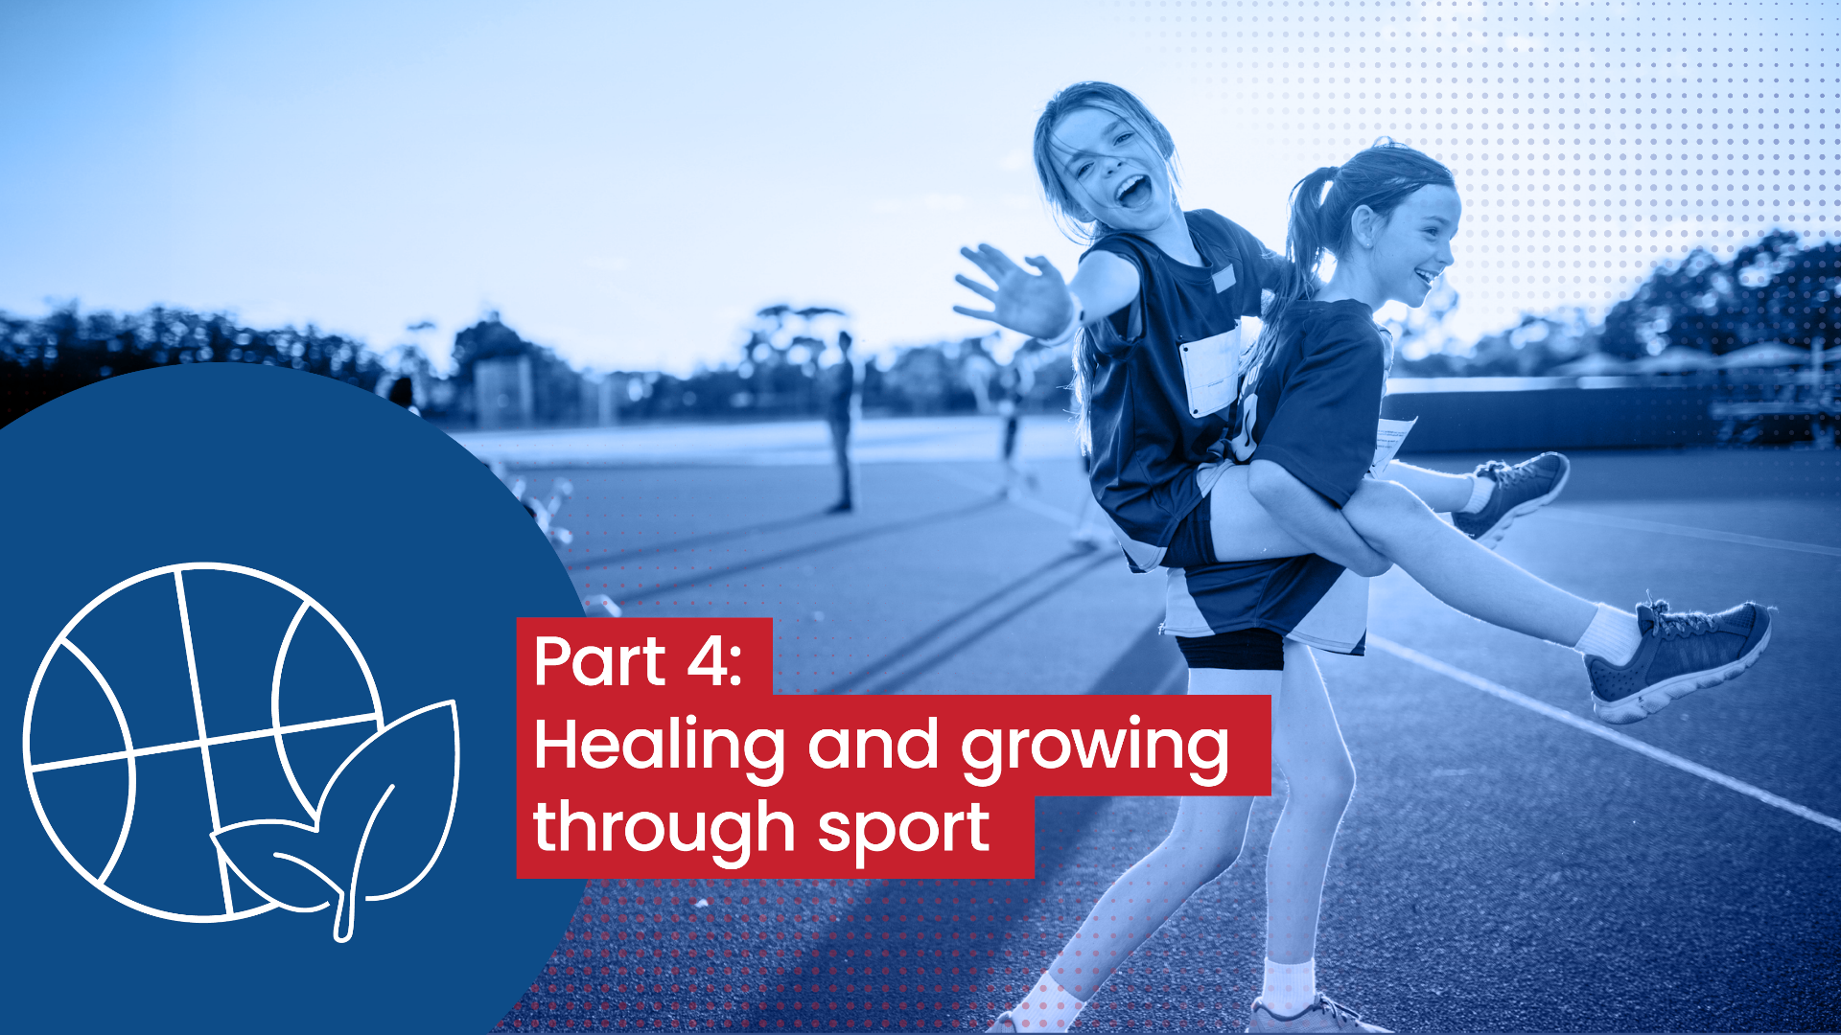
Notes:
Introductory slide
So far we have learnt that trauma can impact children across a lot of areas, but there is a lot we can do to help children heal and recover, including through participating in sport and recreation activities.
As volunteers and coaches, we need to be clear about our role and know our limits. It is not your responsibility to heal children and young people and help them process their traumatic experiences. However, the role you can play is still very important.
As a leader, coach or organiser, you can ‘make or break’ a child or young person’s experience of your activity. Participation in sport and recreation can be a gateway to countless positive new experiences and opportunities to develop skills and connections.

Slide 25
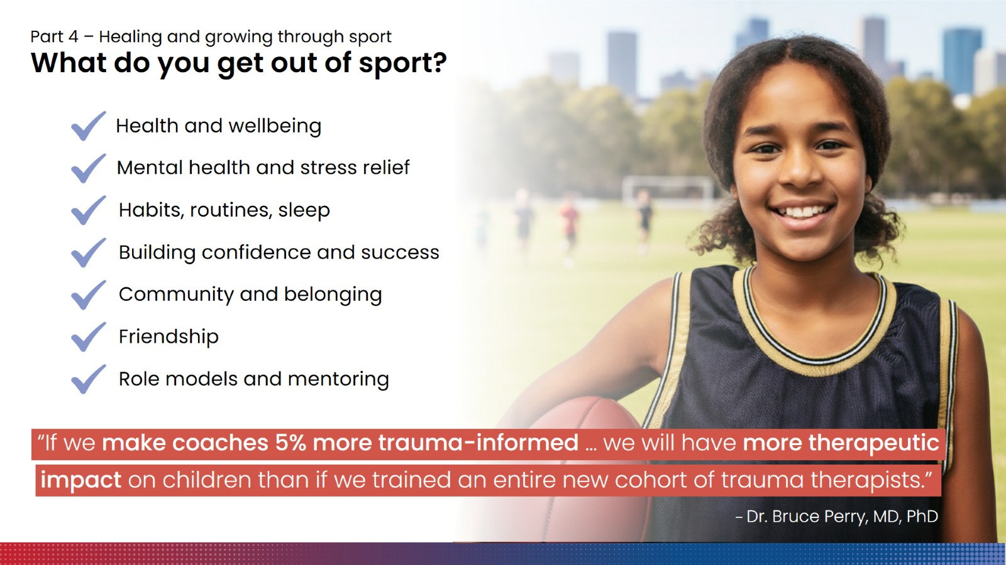
Notes:
Benefits of sport
Discussion prompt
What do you get out of sport? If you have kids, what do they get out of it?
Take some ideas.
There are no wrong answers here.
Following discussion, click to reveal the graphic outlining key benefits of sport.
Participation in sport and recreation is incredibly beneficial for children and young people.
It reduces the risk of health issues and chronic disease and also improves our sleep.
It can assist with cognitive development, learning, and engagement in school.
It can help build habits and routines that keep kids healthy and active throughout their lives.
Team-based sport in particular can help improve resilience, build social connections, and provide positive role models.
Young people who are involved in community sport and recreation have been shown to exhibit greater levels of trust in others, a sense of belonging, closer friendships, greater life satisfaction, and a desire to give back to their community.
There are certain aspects of sport and exercise that are uniquely suited to helping heal and recover from the impacts of trauma.
So much so that some leading childhood trauma specialists believe that, if we can give our sports coaches an understanding of trauma, the therapeutic impacts can be substantial.

Slide 26
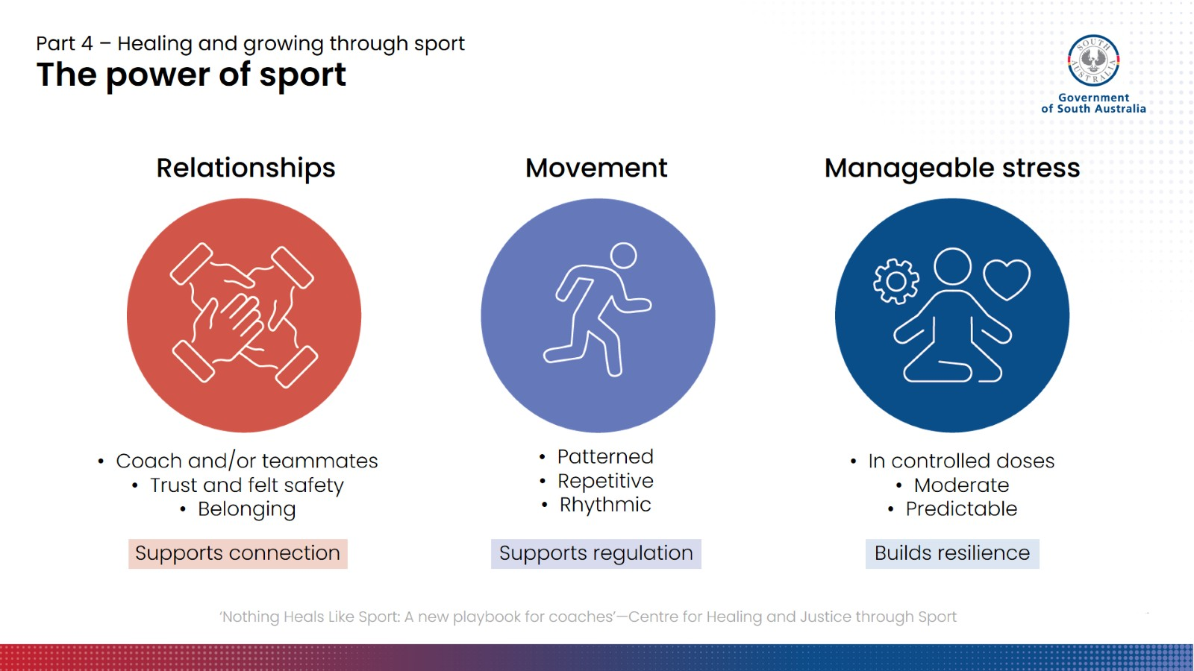
Notes:
The power of sport
So, why are childhood trauma experts saying this? What makes sport so therapeutic?
To be clear – it isn’t sport itself that is therapeutic, but the things that sport can contain, when the conditions are right.
We are going to talk about three key elements of sport that are uniquely suited to helping children and young people who have experienced childhood trauma.
Relationships
The first element is relationships.
Every positive relationship in a young person’s life is incredibly important – not just the one with their primary caregiver or their therapist. In fact, the quality of a child or young person’s relationships and social connections can be a better predictor of healing and recovery than how severe their original trauma was.
However, as we spoke about in the last section, children who have had unsafe and poorly attached caregivers have developed a relationship ‘rule book’ that doesn’t just allow them to trust and let people in. What this means is that developing trusting relationships in which children and young people can heal might take some time, and may not always be straightforward.
Young people may need many years’ worth of positive, safe experiences with reliable adults who care about them in order to start to rewrite their ‘rule book’. These positive experiences of relationships act like snippets of daily ‘therapy’.
Sport is an amazing way for kids to naturally develop positive and supportive relationships with coaches and teammates, simply through having shared interests, playing together, and doing other fun activities. These are bonding activities that don’t feel too serious for children and young people, and so are less high-stakes and confrontational. They may even start to let their guard down without realising. When a young person feels they can trust their coach and teammates, even if just in the sports context, they are able to experience connection and to feel safe in that connection.
Relationships and a social support system create the foundation for children being able to take risks and try new things.
Movement
Sport and physical activity largely consists of movements that are patterned, repetitive, and rhythmic, which can help us to reduce stress and feel regulated. When we engage in this kind of movement, it can also act like rehabilitation for an injury.
When we do rehab for injuries, we engage in repetitive movements that help us to rebuild and train the injured joint or muscle. Although the brain is not a muscle, it can function like one. As children spend time moving their bodies, they become more familiar with what regulation feels like and can get better at it over time.
Manageable stress
The antidote for a child who has been exposed or prone to overwhelming amounts of stress is not to try to create an environment that contains no stress. It is to provide ‘doses’ of manageable stress, just enough for children to stretch themselves a little bit each time to be able to learn and grow, but not so much that they become overwhelmed. This is also a basic principle of sport, exercise, rehab, or learning how to do just about any new skill or activity. For instance:
Building up to be able to run 5k over a 6-week training plan.
Progressive overload in the gym lifting weights to build muscle and get stronger.
Learning to swim in the shallow end of the pool, with flotation devices at first.
Sport is full of opportunities to engage children in experiences of dosed, manageable stress. As children are exposed to moderately increasing levels of stress, in safe and supportive environments, they have opportunities to build their resilience.
To be clear – sport is not a replacement for therapy from a qualified professional. However, what we know about healing from trauma is that it cannot happen in the therapy room alone. Healing and recovery from trauma occurs through the everyday living of life.

Slide 27
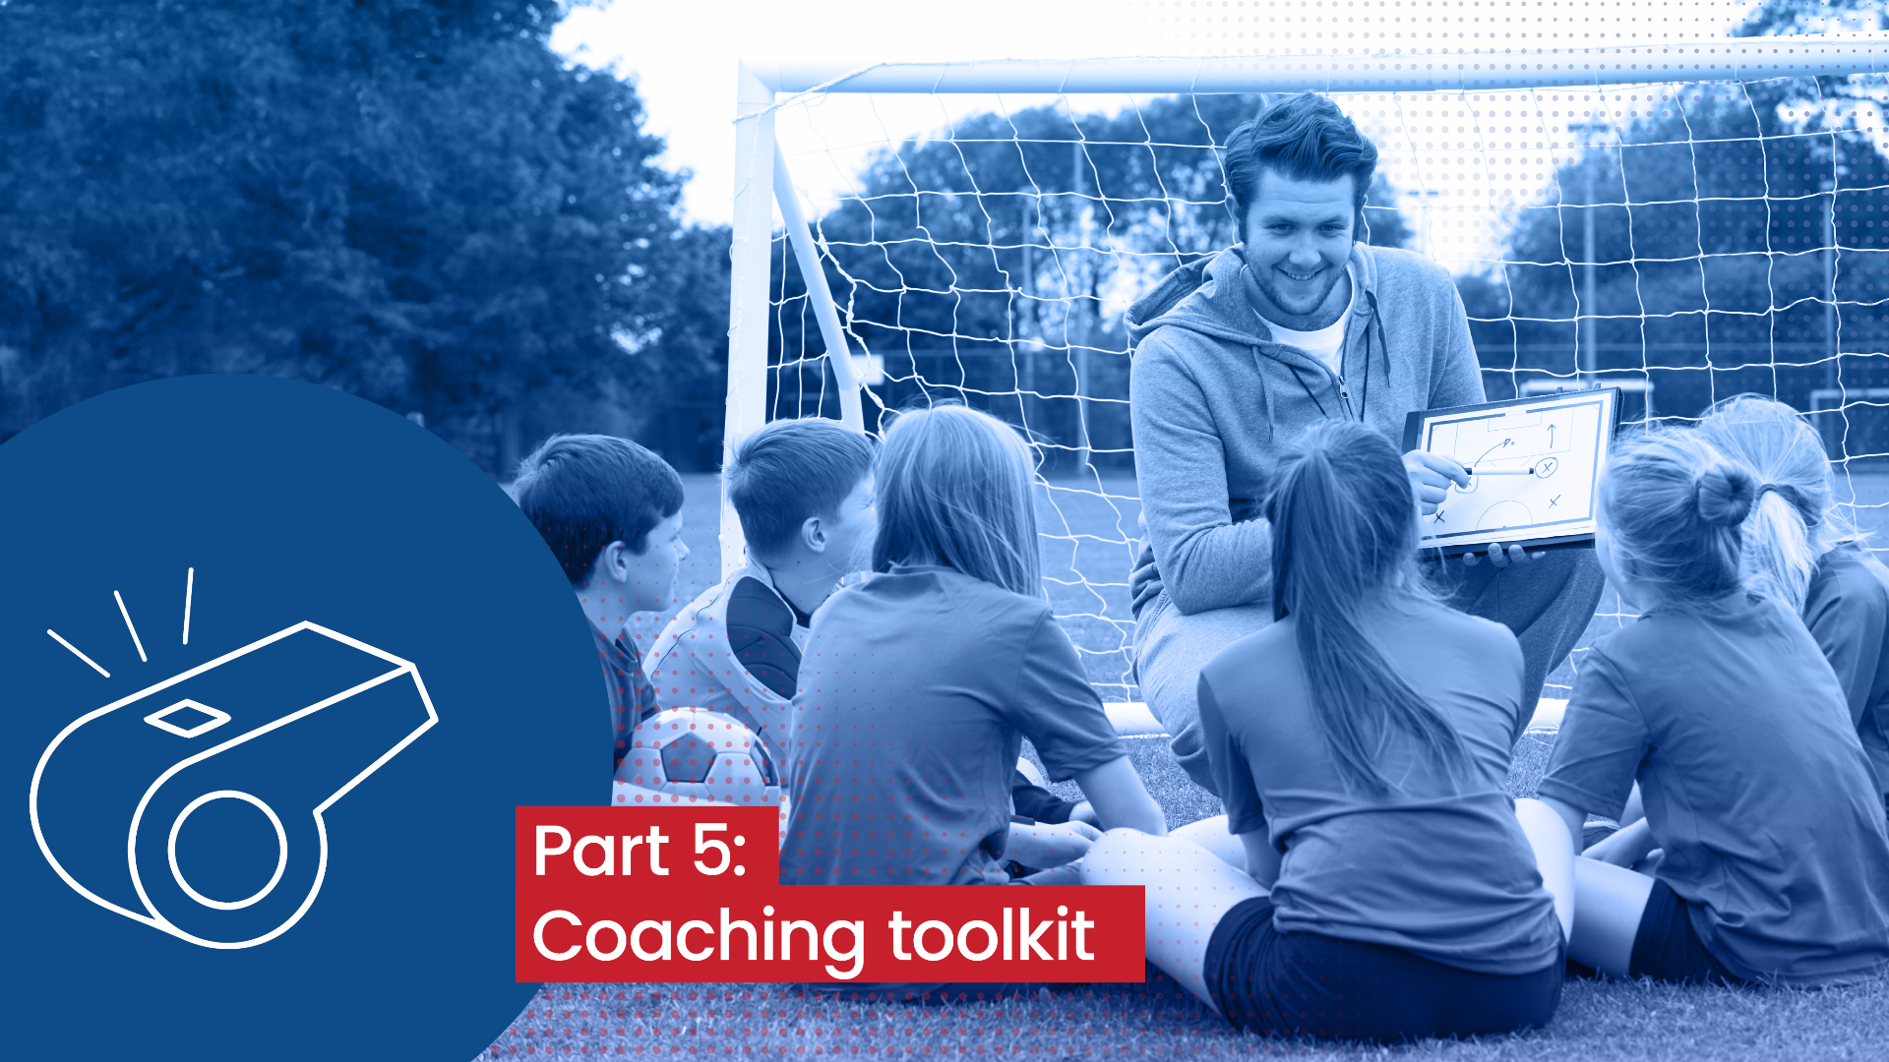
Notes:
Introductory slide
In this last section, we will pull what we have learned together and look at some practical tools, ideas and strategies for engaging with children and young people and creating sport and recreation environments where they can get the most out of their participation.
These strategies and tools are not intended to completely replace your current approach, or tell you you’ve been doing things wrong. They are also by no means exhaustive or rigid. The idea is you can select the strategies and tools you think are most relevant or useful to your context, and tailor and adapt them as you need.

Slide 28
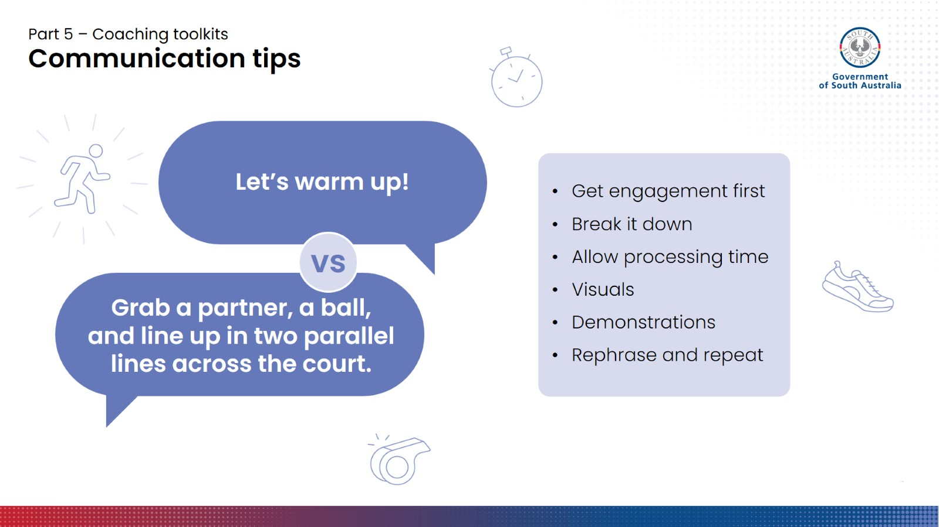
Notes:
Communication tips
First, let’s talk about communication. Communication is a coach’s number one tool. The better you are able to communicate with your players, the more effective of a coach you will be.
In the previous section, we talked about how working memory can be affected by trauma and how ‘flipped’ our lids are, and a byproduct of this can be the ability to take in and figure out how to action verbal instructions. In addition, we also know that a child’s ability to action a verbal instruction you give decreases as it becomes more multi-step, abstract, or new/non-routine.
For instance, “let’s warm up” is a very simple instruction, especially if they are familiar with what that means and have done it before. But let’s assess the second example: “Grab a partner, a ball, and line up in two parallel lines across the court”. How many individual parts do kids have to work their way through in order to understand this instruction?
Can anyone think of a way we could break that instruction down, or change up our delivery?
Take some ideas.
Encourage the group to come up with their own strategies and ideas.
If they seem stuck, you might suggest they think about how they would change their communication if they were coaching a group of 5-year-olds instead.
Ideas might include: (you may not need to do all of these things)
Make sure you have engagement first. This will cue to the child that it is time to listen.
Pause between each component of the instruction to allow comprehension time before moving onto the next one: “Ok first, everybody grab a partner.” Wait until everyone is paired up before proceeding. “Now, each pair needs one ball.” Wait until every pair has a ball. Etc etc.
Pick up the piece of equipment you want them to select: hold up a ball / point to the ball bag as you tell the team to grab a ball.
Guide children into their positions.
Rephrasing and repeating your instruction to the whole group can provide multiple opportunities for kids who may not grasp the instruction the first time to hear it again, said differently, and piece together what you want them to do.

Slide 29
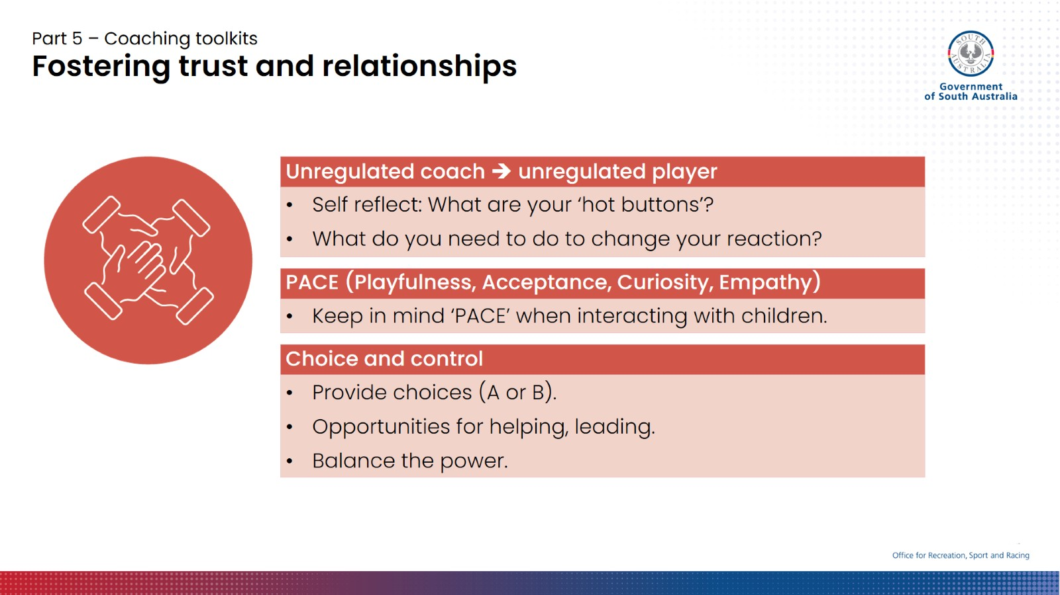
Notes:
Fostering trust and relationships
In the last section, we talked about relationships and positive social interactions being key for healing from trauma and how sport can help facilitate this.
We can’t tell you how to form a connection with a child or young person – there is no one-size-fits-all approach. However, there are some things that, if we keep them in mind and try to put them in practice, can help put us on the right track.
Unregulated coach, unregulated player
Be aware that your mood is contagious.
If you want children to be calm and happy during your activities, it is important that you exude this energy, too, so children feel safe and welcomed into the environment.
This becomes even more important when a child starts to become anxious, argumentative, or dysregulated.
You need to have the fundamental skill of being able to stay in control of your own emotions and behaviour, even when things are challenging and you are getting stressed out.
Many of the more complex behaviours and situations that come along with trauma can be ‘hot buttons’ for us.
If you can think about what your hot buttons are, you may find yourself more able to check your reactions to them. For instance: aggressive behaviour or loudness, lying/dishonesty, not knowing how to help someone, not listening/having to repeat yourself, etc.
(FACT SHEET 1: TAKING CARE OF YOURSELF)
PACE (Playfulness, Acceptance, Curiosity, Empathy)
We can also make an effort to go about our interactions with children keeping in mind ‘PACE’.
PACE stands for: playfulness, acceptance, curiosity, empathy.
Playfulness is well-tailored to sport and recreation, and can be used in interactions to promote connections and diffuse conflict. Maintaining a sense of ‘lightness’ can involve making jokes as well, although use this wisely. There is a big difference between using humour, and joking at the child’s expense or making light of their suffering.
Acceptance means accepting the emotions and needs that are being expressed, even if a child’s behaviour is not acceptable. Sometimes this will mean accepting that they had a good reason, without questioning it.
Curiosity is about wondering where certain behaviours and emotions might be coming from. You might be able to do this with the child, out loud, but if the opportunity isn’t there – and often in coaching situations it may not be because – this can just be an internal prompt. We can ask ourselves: What was happening underneath the surface that made that happen? What skill is this child missing?
Empathy means to show compassion and that you understand how a child might be feeling.
Importantly, these elements don’t mean there are no boundaries around challenging behaviour and that anything goes. It just means that when we interact with kids, we make an effort to connect with their current level of emotion. Once children understand that you are there with them, often they can stop showing you that emotion through their behaviour.
Choice and control
Giving young people choice and control is not about giving up the reins as coach completely. It is about giving young people some control over their experience, and recognising that as the coach/leader in the environment, you have authority by default, and how you choose to use it is important.
This can be really important for kids who have had negative experiences with adults holding power over them, and feeling not in control of what happens to and around them.
Some ideas for this:
A or B choices – are there situations where you can provide a limited set of options that kids can choose between?
Opportunities to help and lead – are there situations you can create where a child can help out and feel they have contributed, even in just a small way?
Balance the power – what can you do to reduce this? Could you get down onto a child’s level so you aren’t towering over them? Could you set up a situation which allows the child to teach you something in return?

Slide 30
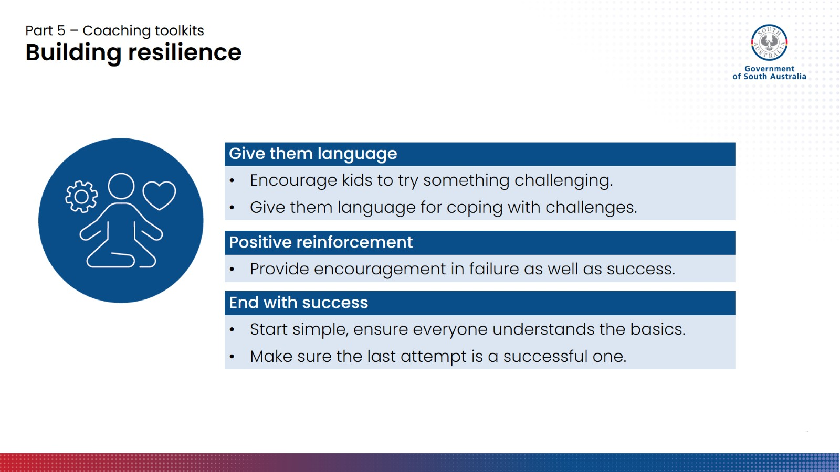
Notes:
Building resilience
We know that taking risks to try something new and leaving our comfort zone is part of learning, but this can be really scary for some kids – and not just those who have experienced trauma!
You will need to be the judge of what controlled doses of stress look like, in the context of the kids you are working with and the sport or activity you are doing.
We just want to provide you with a few more practical tips and strategies that can help children and young people feel safe, supported and encouraged to be able to take those risks and enter the resilience-building zone.
Give them language
When we are encouraging kids to try something challenging, one way we can help gauge how they are travelling is by giving them language to talk about it.
For instance, you might use a traffic light system where green means feeling comfortable, yellow is a little uncomfortable or in the ‘stretch’ zone, and red is very uncomfortable or getting into the ‘panic’ zone.
This not only gives kids an experience of saying how they’re feeling, but when you respond to that and they know they can pull back the challenge when they go too far into the red zone, they feel more in control.
Ideally the yellow zone is where we want to be, and bear in mind every kid will have a different tolerance for how long they can spend there.
Positive reinforcement, in failure as well as success
Positive reinforcement is not just for when things go well.
When kids don’t succeed at something challenging or make a mistake, this is a critical time to provide encouragement. Praise them for being brave enough to try.
End with success
It is common practice, particularly when teaching juniors and beginners new skills, to start simple and make sure everyone has nailed the basics before adding on the next layer of difficulty.
When you are getting ready to end the activity, one strategy you can use is to make sure the last attempt is a successful one.
Sometimes this might involve pulling back the challenge to an easier phase of difficulty.

Slide 31


Part 5 – Coaching toolkits
Early warning signs for ‘flipped lids’
  Voice getting louder
  Verbal outbursts
  Asking the same questions over
  and over.
  Pacing/stomping
  Looks visibly agitated/anxious
  Trying to control others
  Negative self-talk
  Increased clinginess
  Avoiding others/isolating self/hiding
  Going quiet, not engaging
  ’Spacing out’
  Giving up easily
  Kids are individuals – no two situations will look exactly alike.
Notes:
Early warning signs for ‘flipped lids’
So far, we have discussed a few strategies and tools that we can use to support children in our sport and recreation environments to get the most out of their participation and to learn new things, step outside their comfort zone, and develop positive connections.
However, from time to time, things may happen that cause children’s stress levels to exceed their ability to cope. When this happens, they may start to show signs they are about to ‘flip their lid’.
Has anyone had an experience where a kid in their session just flipped their lid? Were there any telltale signs?
Encourage the group to share experiences and think about what some of the giveaways might have been, and whether they saw it coming or not.
Facilitators can also use this as an opportunity to share their own experiences.
Some of these signs are clearly more noticeable than others – a child who is yelling or stomping around is more obvious than a child who has suddenly gone quiet. Some children, when overwhelmed, retreat inwards. Those inward, less noticeable behaviours will be far less disruptive to your session, and so might be harder to pick up on. But these children still need your support to come back out of their overwhelmed state and to get the most out of their participation.
As we learned earlier, each child has an individual set of experiences and behaviours, so no two situations are going to look exactly the same. Kids might show signs that are quite unique to them that they are not coping well, which naturally become easier to identify the more you get to know them.
Being able to identify some of these signs so you can intervene early is a great skill to have. Not only will children have a better time participating because they are feeling supported and heard, your sessions will also likely run a lot smoother. However, bear in mind that some kids’ lids can flip very quickly, and despite our best efforts, we can’t always prevent this from happening.

Slide 32
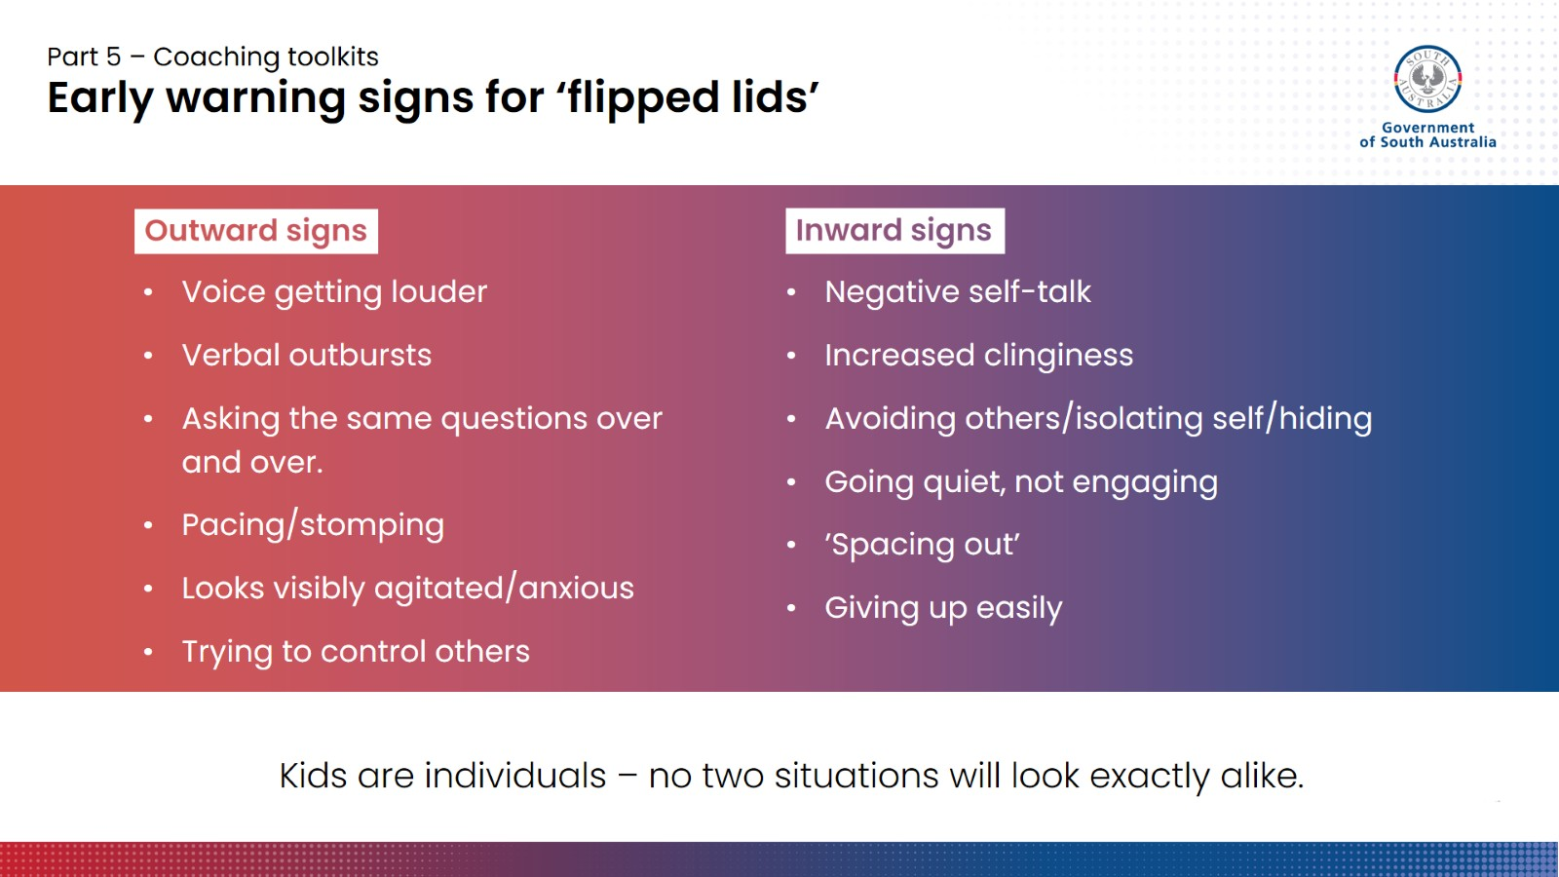
Notes:
Early warning signs for ‘flipped lids’
So far, we have discussed a few strategies and tools that we can use to support children in our sport and recreation environments to get the most out of their participation and to learn new things, step outside their comfort zone, and develop positive connections.
However, from time to time, things may happen that cause children’s stress levels to exceed their ability to cope. When this happens, they may start to show signs they are about to ‘flip their lid’.
Has anyone had an experience where a kid in their session just flipped their lid? Were there any telltale signs?
Encourage the group to share experiences and think about what some of the giveaways might have been, and whether they saw it coming or not.
Facilitators can also use this as an opportunity to share their own experiences.
Some of these signs are clearly more noticeable than others – a child who is yelling or stomping around is more obvious than a child who has suddenly gone quiet. Some children, when overwhelmed, retreat inwards. Those inward, less noticeable behaviours will be far less disruptive to your session, and so might be harder to pick up on. But these children still need your support to come back out of their overwhelmed state and to get the most out of their participation.
As we learned earlier, each child has an individual set of experiences and behaviours, so no two situations are going to look exactly the same. Kids might show signs that are quite unique to them that they are not coping well, which naturally become easier to identify the more you get to know them.
Being able to identify some of these signs so you can intervene early is a great skill to have. Not only will children have a better time participating because they are feeling supported and heard, your sessions will also likely run a lot smoother. However, bear in mind that some kids’ lids can flip very quickly, and despite our best efforts, we can’t always prevent this from happening.

Slide 33
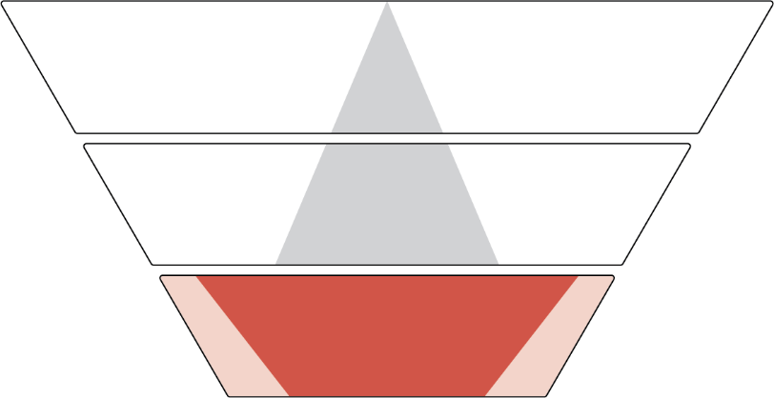


Part 5 – Coaching toolkits
Supporting overwhelmed kids
Thinking centre
(Cortex)
Emotion and
movement centre
(Mid-brain)
Body centre
(Brain stem)
Calm
‘Fight, flight, freeze’ / ‘Survival mode’
/ Dysregulated (lid = off)
Notes:
Supporting overwhelmed kids
So how can we support a child who is becoming overwhelmed and about to flip their lid, or maybe already has?
To help us answer this question, we need to go back to our model of the brain from part 1. [click to reveal first image]
When a child is looking like are flipping their lid, this means their brain has directed energy to the ‘staying alive’ area of the brain. Their thinking centre is losing, or has lost, control.
[click] Knowing this, if we try to appeal to the thinking centre right now, and try to make the child see the cause and effect of their behaviour or reason with them to stop, how do we think that is going to go? Probably not that well. So which centre do we need to try to connect with instead?
[click to reveal] The answer is the one that’s in control – the ‘staying alive’ or survival centre. We need to meet the child where they’re at, by helping them to turn off their body’s alarm system and bring their stress levels back within manageable limits.
We are going to highlight a few tools here that can help with this.

Slide 34
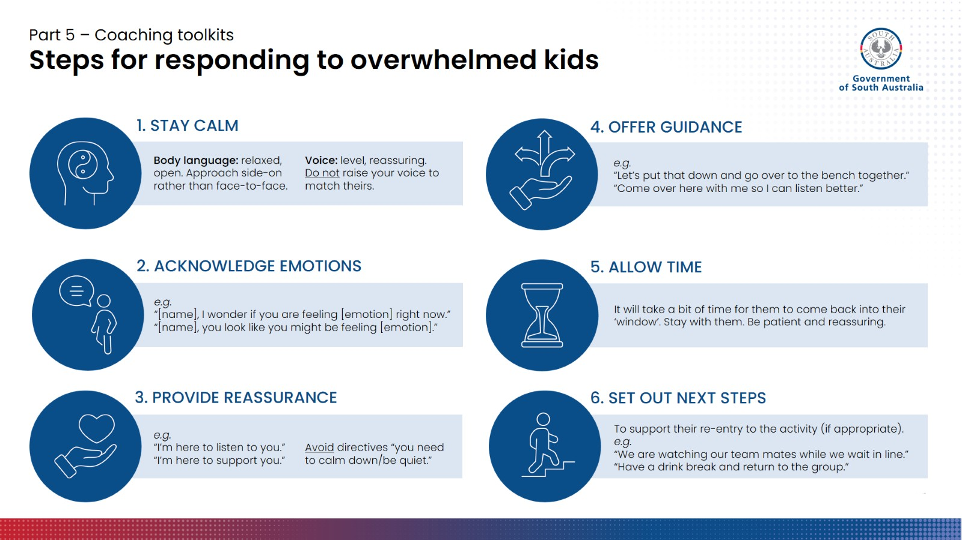
Notes:
Steps for responding to overwhelmed kids
This is a simple, practical sequence of steps for approaching and supporting a child who you can see has flipped their lid. This sequence is intended to guide you in how you respond in those immediate situations where something is going down.
Step 1 is something we have already discussed today. When you are approaching a child who has flipped their lid, bear in mind they are ready to fight or flee the situation, so it is really important that you don’t come across as representing a further threat to them. Your own ability to stay calm and in control of your own emotional reactions is absolutely critical.
In a practical sense, you can do this by remaining level and not matching their raised voice with your own raised voice. Ensure your body language remains relaxed and open. Don’t stand over them or approach them directly – instead consider a side-on approach, or getting down to their level. Make an effort to consciously check in with how your body language and tone of voice could be perceived. You may find you have tensed up without realising, understandably – these situations can be stressful! If you need to, use one of the strategies for self-regulation on your fact sheet.
Step 2 is about putting words to the emotions you are seeing, because that child probably can’t right now. But rather than putting words in their mouth, we can phrase these as curious and empathetic statements. For instance, ‘I wonder if you’re feeling angry’, ‘You are looking a bit upset right now‘.
Step 3 goes really well with step 2, and is about following up that emotion identification with reassurance that you are there to listen and support and maybe help solve a problem. Avoid demands and directives.
Next, you can start to offer some gentle guidance, but again avoiding things that come across as ‘must-do’s or demands. If we can phrase things as requests or suggestions, they may be better received. Avoid telling a child to ‘just calm down!’ By doing this, you are essentially telling them to do something they are not immediately capable of achieving. Instead, consider asking them to do something concrete and achievable, like move to another location with you.
Tip: Find your own words and way of talking to kids that feels natural and genuine to you – we don’t want to come across as scripted.
Step 5 is just to allow time and space for the child to calm down. Children cannot always immediately snap back into being regulated. Here is a great opportunity to use some of your PACE skills to connect with them. Assess the situation around whether it might be appropriate to use ‘Playfulness’ – humour can be a great distractor and instant de-fuser (when wielded correctly). This can help to build rapport and let the child know you’re not angry at them, and they haven’t ruined the relationship.
As the child’s thinking centre regains control, you can then set out the next steps for re-entry to the activity. You may want to set out an easy yes/no or two-option choice for how they come back in, to provide the child with a sense of control and choice around what happens next.

Slide 35

Part 5 – Coaching toolkits
Regulation through movement
Deep breathing as a coping skill | YouTube
Notes:
Regulation through movement [deep breathing]
Once we have children somewhere we can really support them, we can work with them to help turn off their alarm system using some calming strategies that directly target the ‘staying alive’ area of the brain.
One way we can do this is through deep breathing. You may have heard of this as a coping strategy for anxiety, panic attacks, etc. It works exactly the same way.
When we start to feel stressed and anxious, our breathing patterns subconsciously change, becoming shallower and faster. To counteract this, we need to focus on deliberately breathing in deeply and slowly, to the bottom of the lungs. These deep breaths help us calm the part of the brain that puts us into ‘survival mode’. Deep breathing can have an immediate effect on lowering your heart-rate, cortisol levels, and re-saturating the amount of oxygen in our lungs and bloodstream.
For these reasons, deep breathing is also a very common performance strategy in sport, used by athletes to help focus the mind and body.
In this video, the athlete outlines a really simple 10-second breathing exercise that works for him.
When it comes to doing this with kids, they may need a little more help to figure out how to actually take a proper deep breath, if they have never done anything like this before. You can prompt them to try to breathe in so deep that they can feel and see their belly expanding, instead of just their upper chest. We don’t need to get them doing it perfectly – just get them focused on slowing things down. Breathing exercises that use imagery and visualisations of things that kids are already familiar with can also be helpful and engaging.

Slide 36
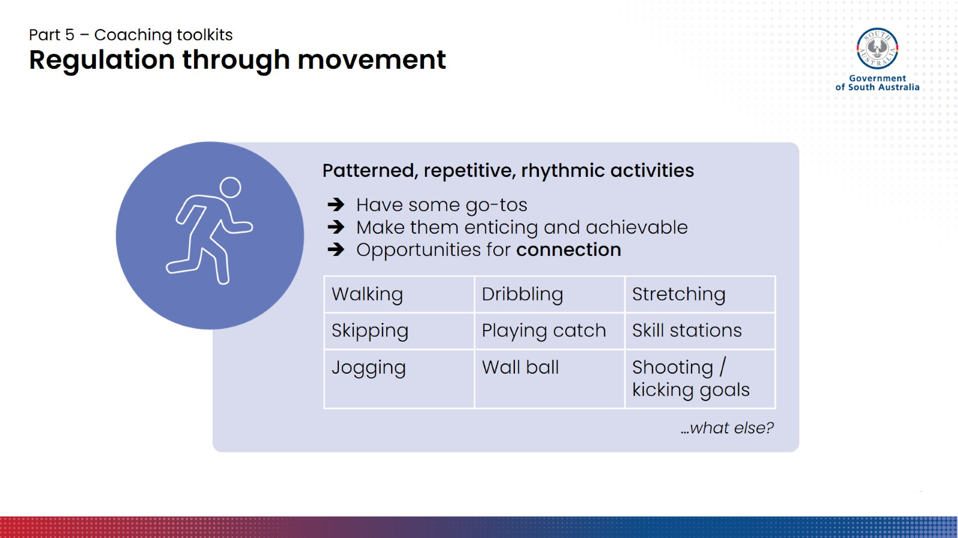
Notes:
Regulation through movement [PRRAs]
Deep breathing is just one tool we can use, but there are many others.
A traditional response for responding to children with flipped lids, exhibiting big behaviours, has been to try to get them to sit still and quietly, but kids actually need the opposite to be able to get their lid back down. They need to get moving. We want to try to encourage (safe) movement that supports them to re-regulate.
Patterned, repetitive, rhythmic activities can be (and probably already are) incorporated throughout your sessions. They are a part of most sports and can take many forms.
It may be worth thinking about what some of these go-to activities might look like for you, depending on what you have available. Have a few ‘go-tos’ for when you sense a child could use a bit of time to recalibrate.
Activities should not come across as punishments or as if they have been ‘exiled’. Kids need activities to be enticing and achievable. They can also be great opportunities for you to connect as well – for instance, tossing a ball back and forth between two people (short distance) allows you to move rhythmically while also having a chat that doesn’t feel like a chat.

Slide 37
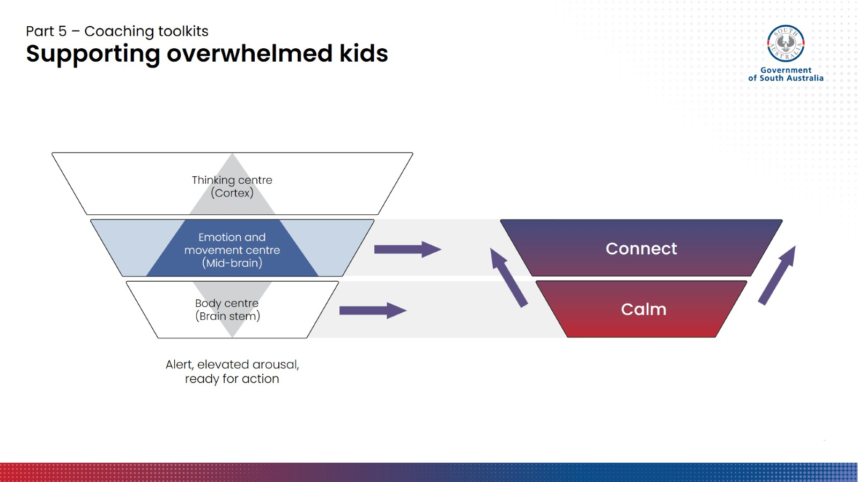
Notes:
Connect.
This idea of connecting during a regulating movement activity leads in nicely to the next phase.
Once children are starting to come out of peak survival mode or ‘flipped lid’ territory, we can start to tap back into the next level up in our brain diagram: the feeling and acting centre. The feeling centre of the brain is all about connection. This step is about reassurance, relating to the child, and establishing or re-establishing connection.

Slide 38
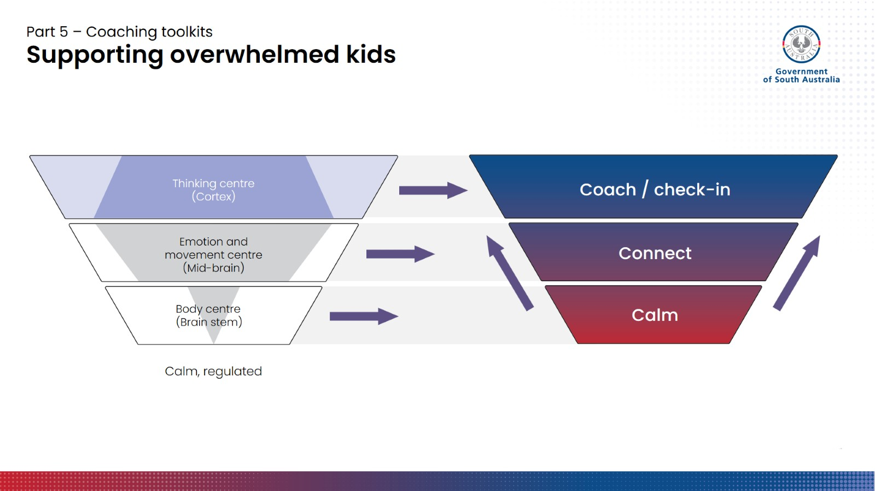
Notes:
Coach.
Finally, as control begins to return to the thinking centre, we can potentially get back to coaching. This step is only possible once you have a child who is calm, and you have established connection.
You cannot coach a highly dysregulated child. You cannot reason with them or use strategies that require the thinking brain. It is not accessible to them while they are in survival mode.

Slide 39
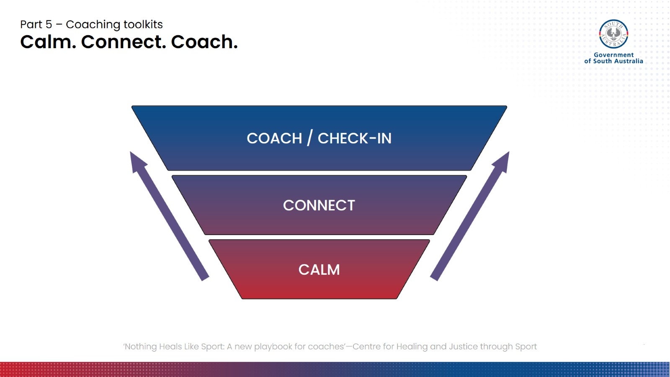
Notes:
Calm. Connect. Coach.
When in doubt, you can always return to this mantra and ask ourselves: which brain centre is most likely in control of this child right now? Do they need me to calm, connect, or coach?

Slide 40
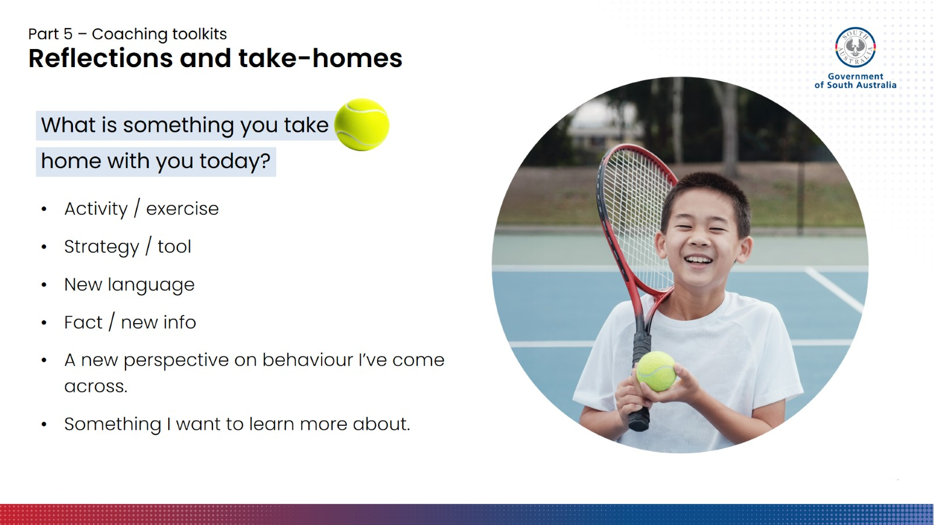
Notes:
Activity (5 mins)
Give participants a few minutes to reflect on what they have learnt today, and what information was new to them or that they found most useful.
This could be:
A new activity they will incorporate
A new perspective on some of the behaviours they may have seen in their own sessions
A new fact or piece of information
A memorable phrase, model (e.g. PACE, Calm Connect Coach), or new language
Something you want to explore further
Ask them to share their main takeaway with the group. If people have more than one, that’s great.
If you have equipment available, you can write these down on the whiteboard or butchers paper, and participants can take photos of their own group-generated summary.
You could also use a live survey/polling app if you have access to one, such as Slido or Mentimeter.

Slide 41
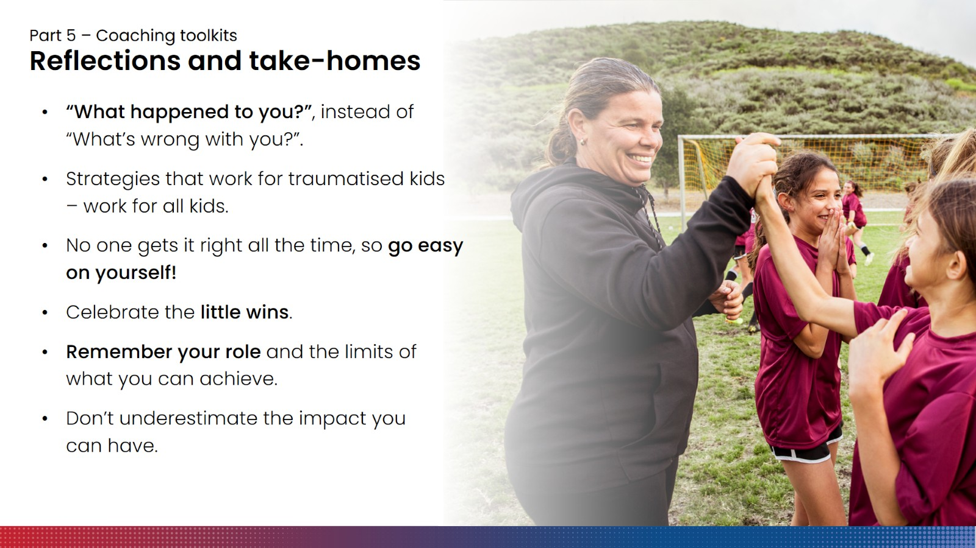
Notes:
Reflections and take-homes [part 2]
A few additional take-home messages we want to emphasise:
‘What happened to you?’ not ‘What’s wrong with you?’ – be curious about what might be going on under the surface. What skills might this child be missing? What do they need more help with?
Strategies that work for traumatised kids work for all kids – don’t be afraid to use your knowledge and skills across a range of situations, and to share what you know.
No one gets it right all the time, so go easy on yourself! There are always going to be limits to what you can do in certain situations, depending on the tools and support you have available to you. Just do the best you can, but you would be surprised how far your best can take you.
Celebrate the little wins – change happens slowly, but if you look out for it, you may notice all sorts of incremental progress.
Remember your role – which basically is to say, it’s not your job to fix everything, but you can play a really important role in creating conditions in your sport environment where kids can heal and grow.
Finally, don’t underestimate the impact that you can have as a coach, facilitator, support person, etc.
Sport contains so many opportunities to help children and young people build resilience and relationships with others that can help them to recover from and work through the effects of the trauma they have experienced. Simply by taking the time to understanding a little bit about trauma and what it can means for a child or young person, you can make a huge difference.
If you can take even just a couple of strategies or learnings with you and incorporate them into your toolkit, you may make it just that little bit easier for a child or young person to get involved, stay involved, and to heal and grow through sport.

Slide 42
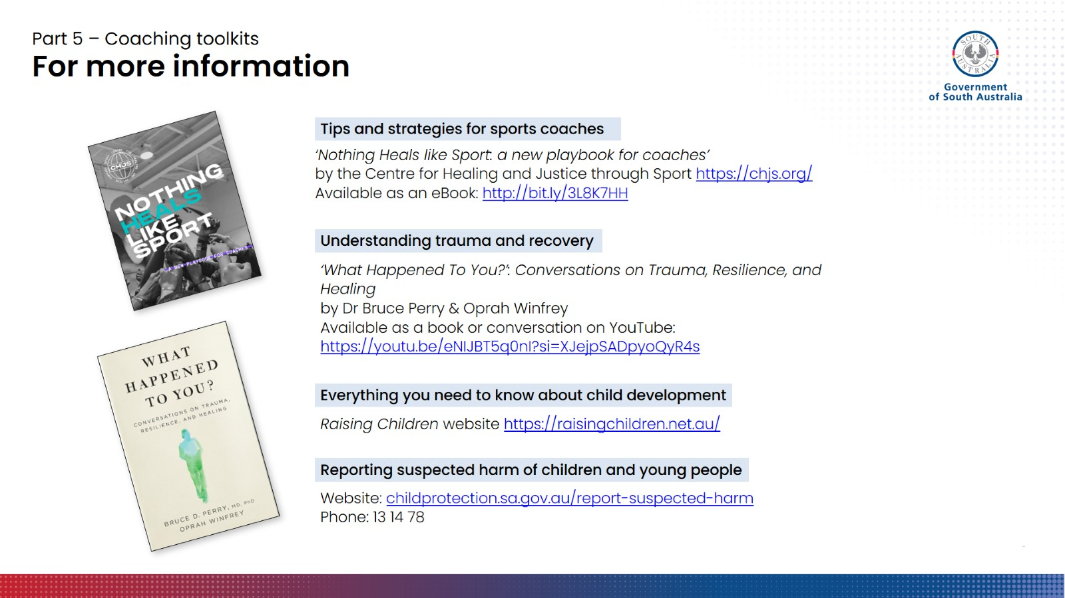

Slide 43


